Slide 1


[MES Logo / Wordmark]

Slide 2
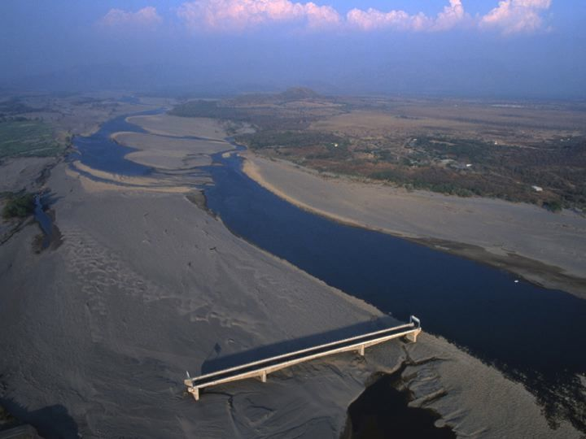
Bridge in Cholocanas, Honduras
Notes:
One of only 7 bridges in Honduras to withstand Hurricane Mitch.
Hurricane changed the course of the river; the bridge no longer spans it.
Like this bridge, our church structures may be strong, but may be irrelevant in our current context.

Slide 3
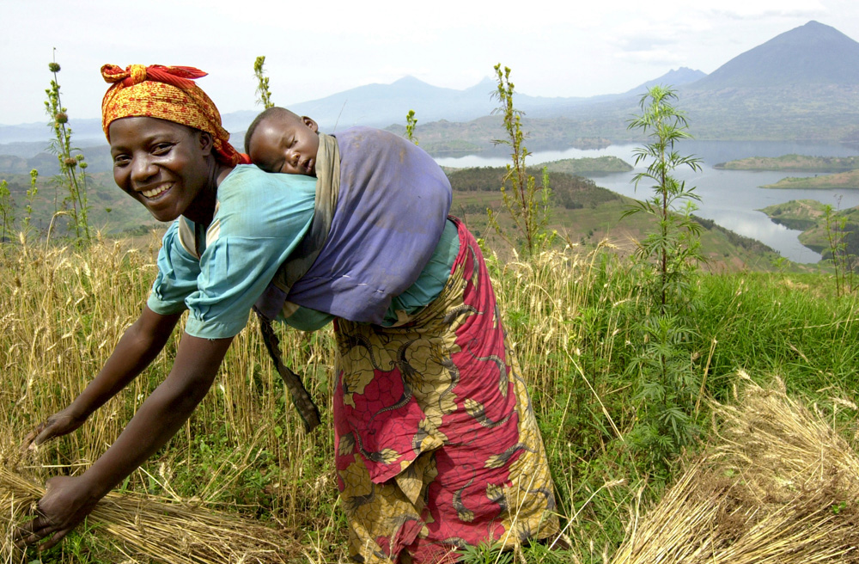
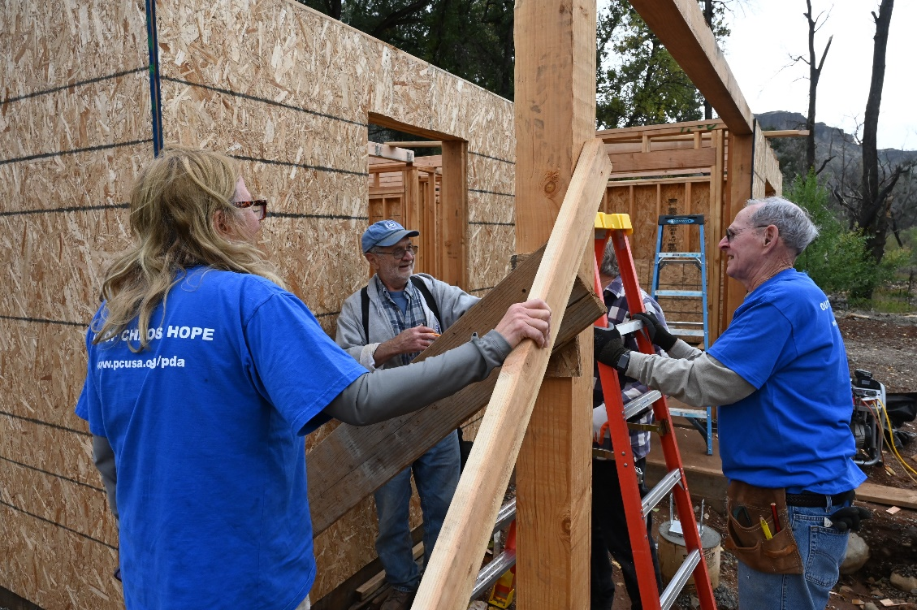
Poverty Alleviation
Presbyterian Disaster Assistance
Presbyterian Hunger
Self-Development of People
Young Adult Volunteers
WFP/Riccardo Gangale
Notes:
PDA:
Presbyterian Disaster Assistance enables congregations, mid councils, and mission partners of the PC(USA) to witness to the healing love of Christ through caring for communities adversely affected by crises and catastrophic events, both natural and human-caused.
Immediate relief work and long-term development work
PHP:
Food – access to land, seeds, funding, water, equipment, training – 21 countries
everyone in the food production process treated fairly
Solidarity – Advocacy for land rights, fair trade policies, migrant worker rights,
affordable housing
Environment – trees, water systems, sanitation
SDOP:
Presbyterians and ecumenical partners dissatisfied with poverty and oppression, united in faith and action through sharing, confronting, and enabling by participating in the empowerment of economically poor, oppressed, and disadvantaged people, seeking to change the structures that perpetuate poverty, oppression and injustice.
YAV:
Ecumenical, faith-based year of service for young people (ages 19–30) in sites across the United States and around the world. YAVs accompany local agencies working to address root causes of poverty and reconciliation. Alongside this work, volunteers explore the meaning of their Christian faith and accountability to their neighbors in the community with peers and mentors.

Slide 4
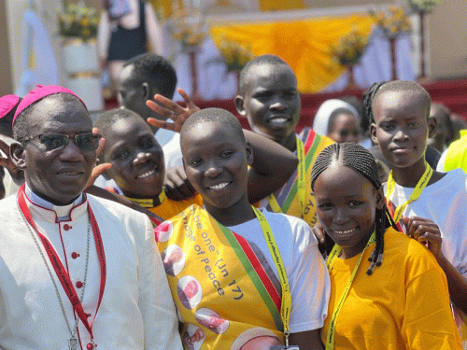
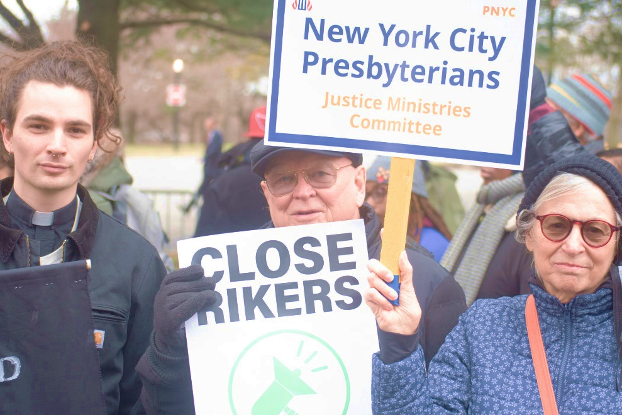
Justice
Ecumenical Relations
Office of Public Witness
Presbyterian Ministry at the United Nations
World Mission
Shelvis Smith-Mather
Notes:
Ecumenical Relations:
Working both domestically and internationally, and inter-religiously the PC(USA) is creating appropriate channels of consultation to clarify further understanding around evangelism, witness, and service, providing resources and support that will assist the church in her efforts to engage in ministry within the local context and beyond. – Partners include World Council of Churches; World Communion of Reformed Churches.
Office of Immigration Issues:
Provides advice and counsel to mid councils and congregations with immigration issues and resources members can use to advocate for more just immigration laws and processes. (GA 216 – 2004)
OPW:
Presence in DC since 1946
Social witness policy of GA
Communicate with policy-makers & staffs – visits, calls
Testify before Congress
Facilitate testimony of church leaders
Action Alerts; Ecumenical Advocacy Days
PMUN:
Hold special consultative status through the UN Economic and Social Council (since 1998)
Represents the PC(USA) on the Security Council Working Group – advisory voice to Council
RE&WIM:
Racial Equity & Women’s Intercultural Ministries engages the Church in its mission to become more diverse and inclusive of racial, ethnic, cultural and language groups, and we equip women for leadership in all ministries of the Church. There are Presbyterian Mission Agency offices supporting African American, Asian, Hispanic/Latino-a, Korean, Middle Eastern, Native American and African Intercultural ministries.
RE&WIM works to achieve gender and racial justice and equip people of color and young adults for leadership. We assist college-age and young women of color in their faith journeys and foster networks of support for them.
World Mission: - 80 countries
Sustainable agriculture
Anti-violence – migration mitigation
Human trafficking
Education

Slide 5
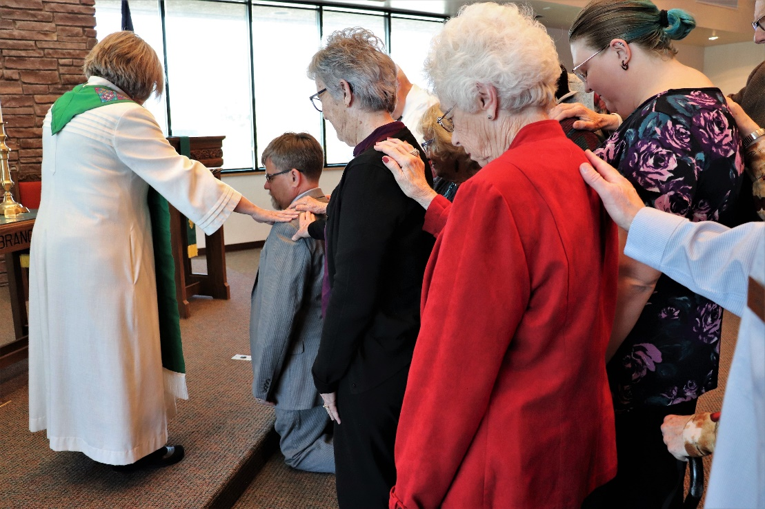
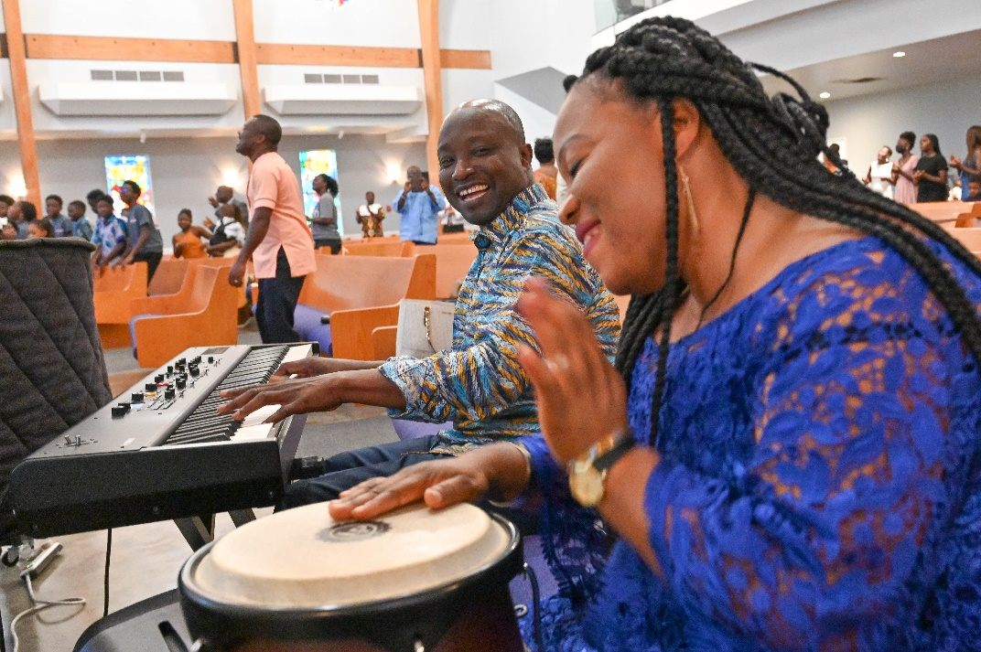
Vitality of Congregations
1001 New Worshipping Communities
Constitutional Interpretation
General Assembly
Leader Formation
Presbyterian Historical Society
Vital Congregations
Presbyterian Mission Agency
Notes:
1001:
Church-wide commitment to ignite a movement that results in the creation of 1001 new worshiping communities.
Constitutional Interpretation:
Advisory Opinions
Conflict Negotiation
GA:
The General Assembly consists of commissioners elected by presbyteries. Half of the commissioners will be ruling elders, half will be teaching elders. It reviews the work of synods, resolves controversies in the church, is responsible for matters of common concern for the whole church, and serves as a symbol of unity for the church.
The assembly seeks to protect our church from errors in faith and practice, is responsible for assuring that the expression of our theology remains true to the biblical standards in our historic confessions. The General Assembly presents a witness for truth and justice in our community and in the world community. It sets priorities for the church and establishes relationships with other churches or ecumenical bodies.
Korean-Speaking:
Support and nurture healthy, connectional Korean-language congregations and presbyteries and second-generation Korean congregations. (222nd GA)
Leader Formation:
Moderators Conference/PBM Conference
Regarding Ruling Elders
Webinars
PHS:
Organized in 1852, the Presbyterian Historical Society is the oldest denominational archives in the United States and serves as the national archives for the Presbyterian Church (U.S.A.) and its predecessor denominations.
Vital Congregations:
7 Marks of Congregational Vitality
Lifelong Discipleship Formation VS. Complacent "Christian" piety, simply teaching good morals, or offering the latest programs.
Intentional Authentic Evangelism VS. “Jesusfreeks"; "Christian" Hypocrisy; An Evangelism committee.
Outward Incarnational Focus VS. Inward Institutional Survival; Closed communities of assimilation/exclusion.
Empower Servant Leadership VS. the Pastor's job; monopolized leadership; hiring the young energetic pastor
Spirit-Inspired Worship VS. Self-gratifying worship, stale ritual divorced of meaning, or consumer entertainment worship
Caring Relationships VS. Any other Social Club; facades, hypocrisy, and judgment of "church" and "religion.“
Ecclesial Health VS. Unhealthy dysfunction; toxic environments; obsolete and irrelevant buildings

Slide 6
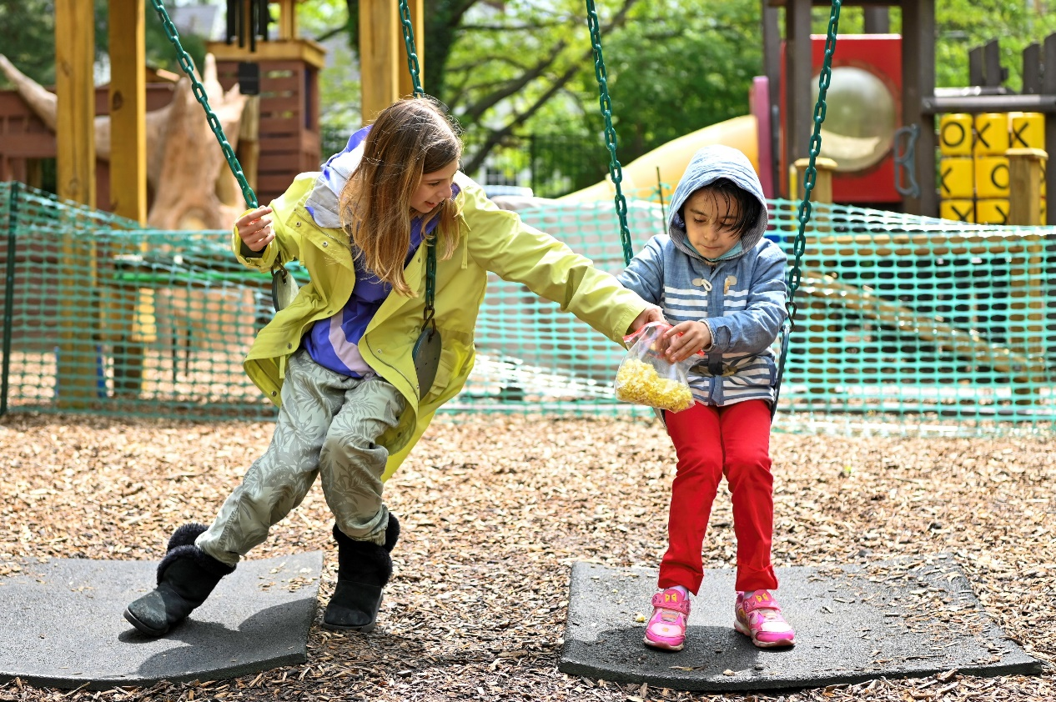
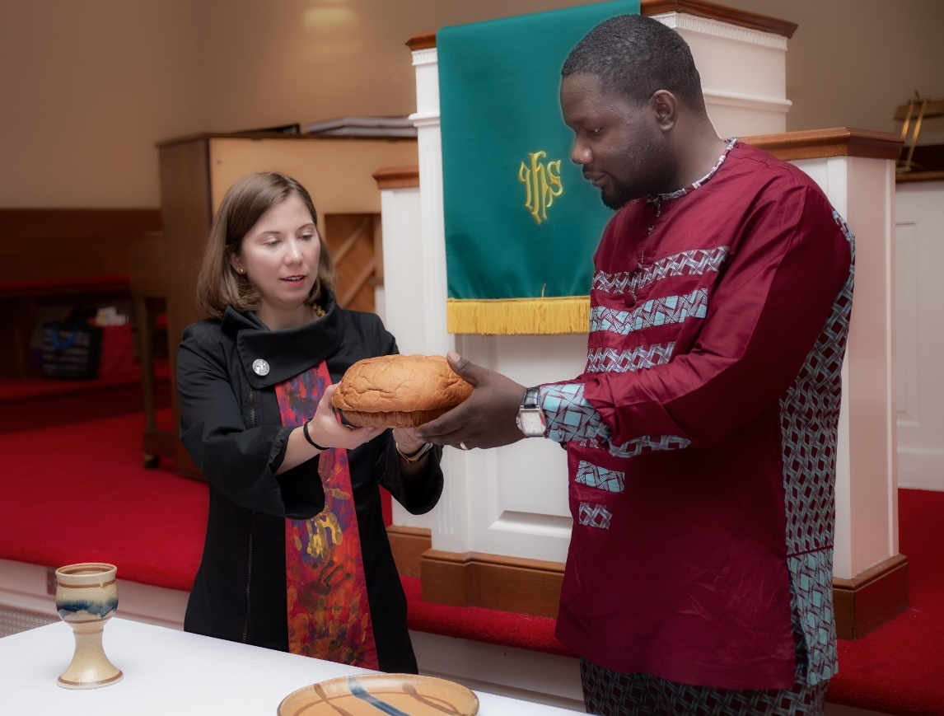
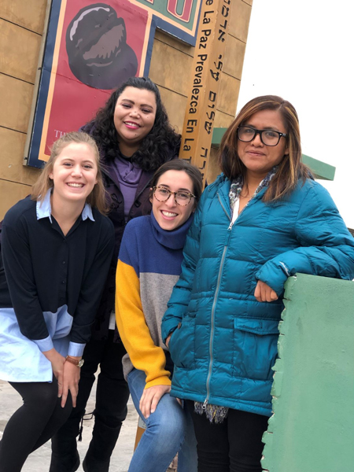
Rev. Mark Adams
Ways to Support – Shared Mission & Designated Giving
Notes:
Shared Mission:
We are the Church, together — congregation, mid council and Mission Agency — living out the call of Christ. Your gifts to Shared Mission, given without restrictions, allow for the Church’s timely response when and where it is needed most.
Designated Giving:
Mission Co-Worker Support
Disaster Relief

Slide 7
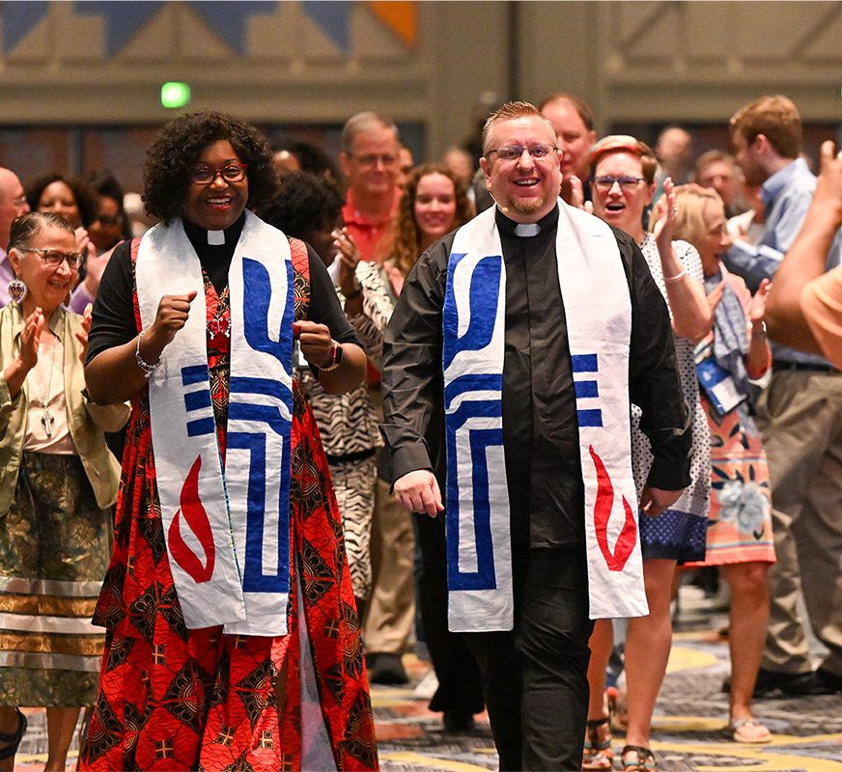
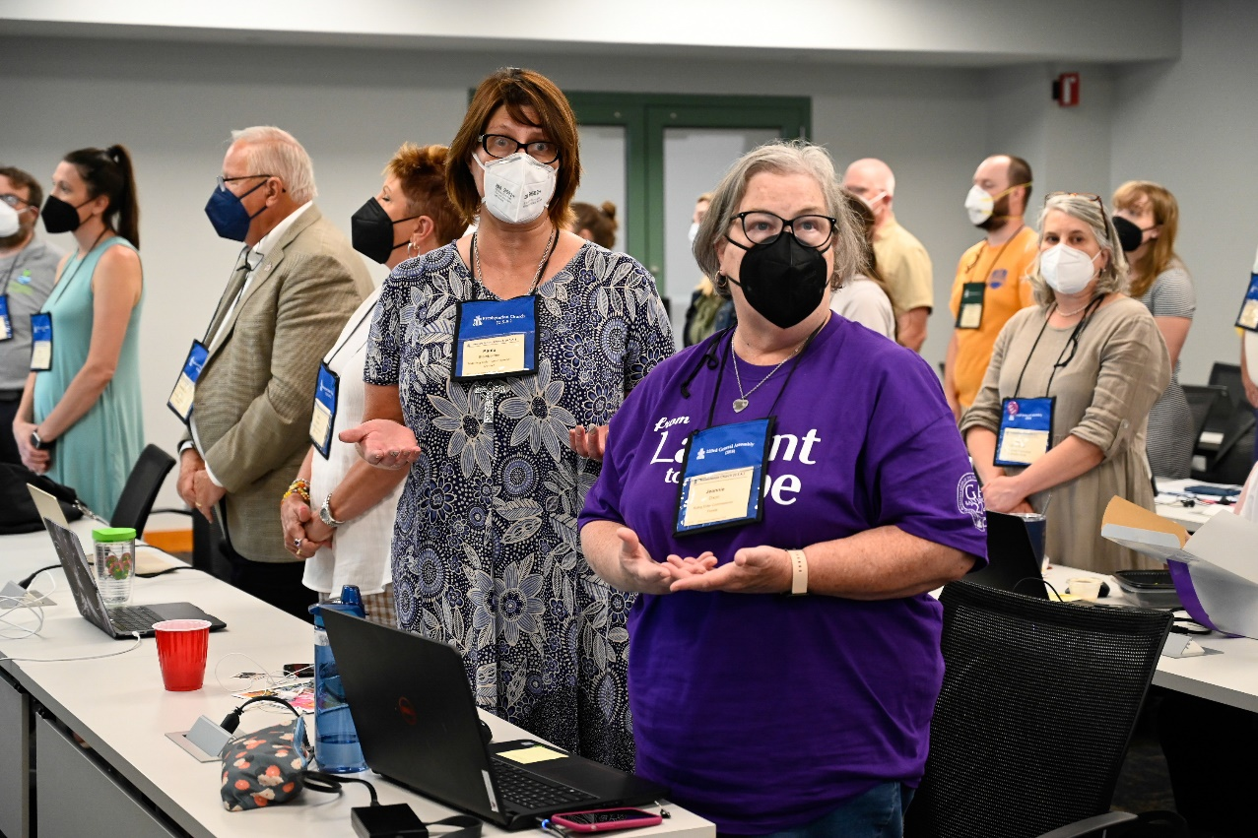
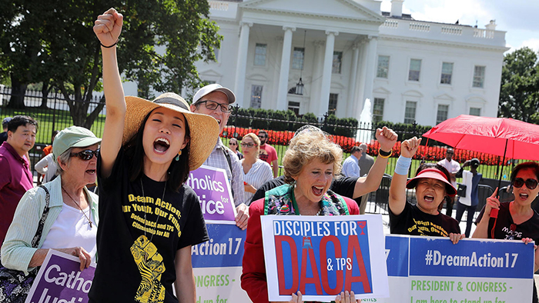
Rich Copley
Rich Copley
Ways to Support – Per Capita
Notes:
Per Capita:
Per Capita connects Presbyterian Church (U.S.A.) congregations and mid councils with the work of the wider church. As the primary source of funding for the Office of the General Assembly (OGA), it is how Presbyterians mutually and equitably share the costs of moving the church forward in the 21st century.
Per Capita giving makes it possible for:
Presbyterians to discern and live out God’s call in their lives
Churches to connect with individuals seeking a call to ministry
Staff support for General Assembly committees and commissions
Management and coordination of General Assembly gatherings
Presbytery and synod leaders to gather for training and discernment
Counsel and support for churches in crisis (misconduct, legal matters)
Presbyteries to address matters of inclusion, participation, and representation at all levels of church leadership and decision-making
The denomination to build connections with ecumenical partners around the world
Presbyteries and pastors to receive support on immigration issues
Presbyterian history to be cataloged, preserved, and utilized by future generations

Slide 8

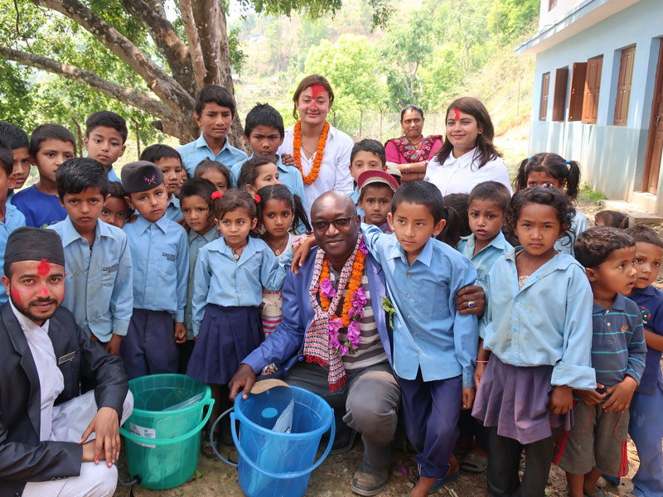



Ways to Support – Special Offerings
Notes:
4 church-wide offerings help share Christ's love with millions of people around the world – close to home and far reaches
Share stories of how you are using your portion of the Pentecost (40%) and Peace & Global Witness (25%) Offerings!

Slide 9

Notes:
Presbyterian Giving Catalog: Celebrating its 10th year. Way to engage families and children in gifts that make a difference in the name of Christ. Small gifts. Big impact.

Slide 10
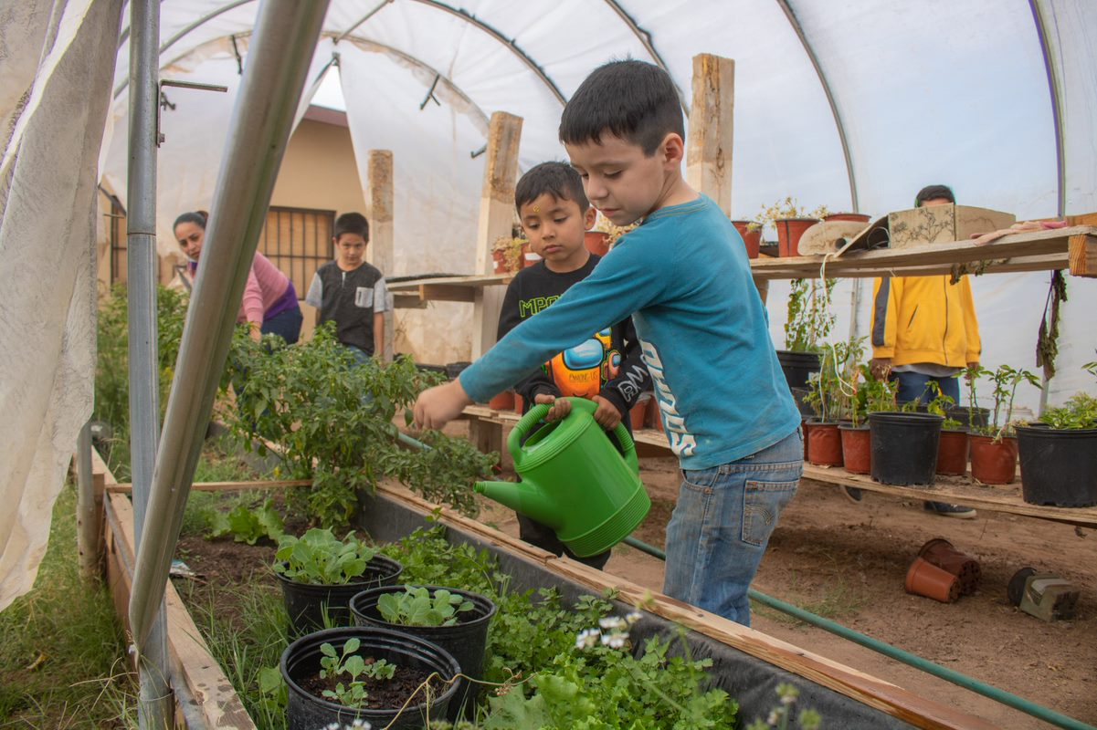
Swahili proverb
“If you want to travel quickly, go alone.
“If you want to travel far, go together.”
Ammi Robles
Notes:
Let’s go far, together!

Slide 11
[MES Logo / Wordmark]

