Slide 1
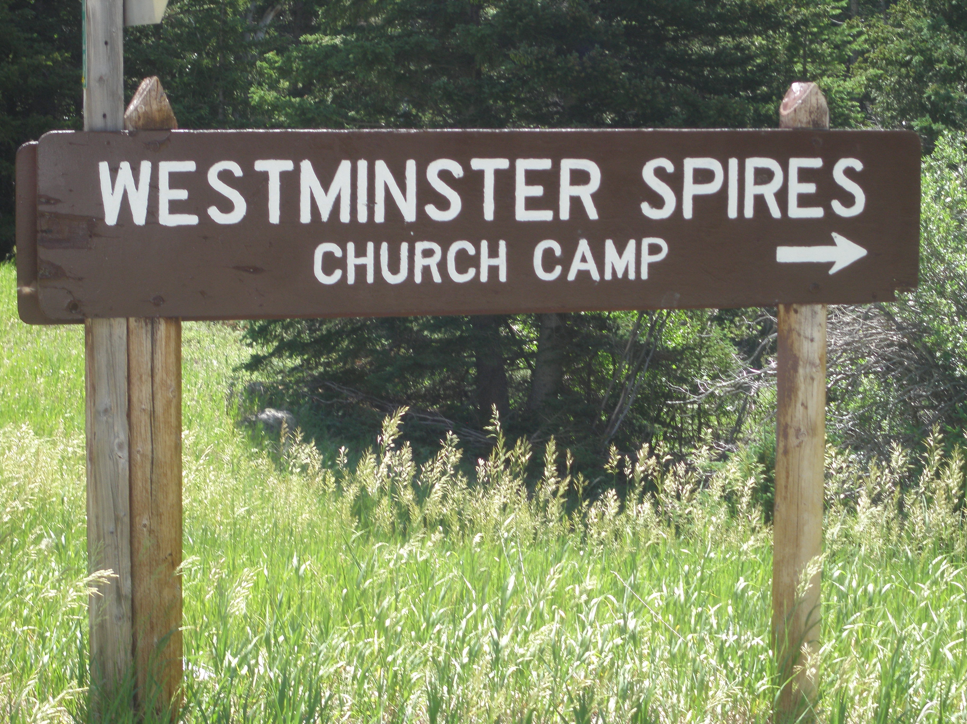

Slide 2
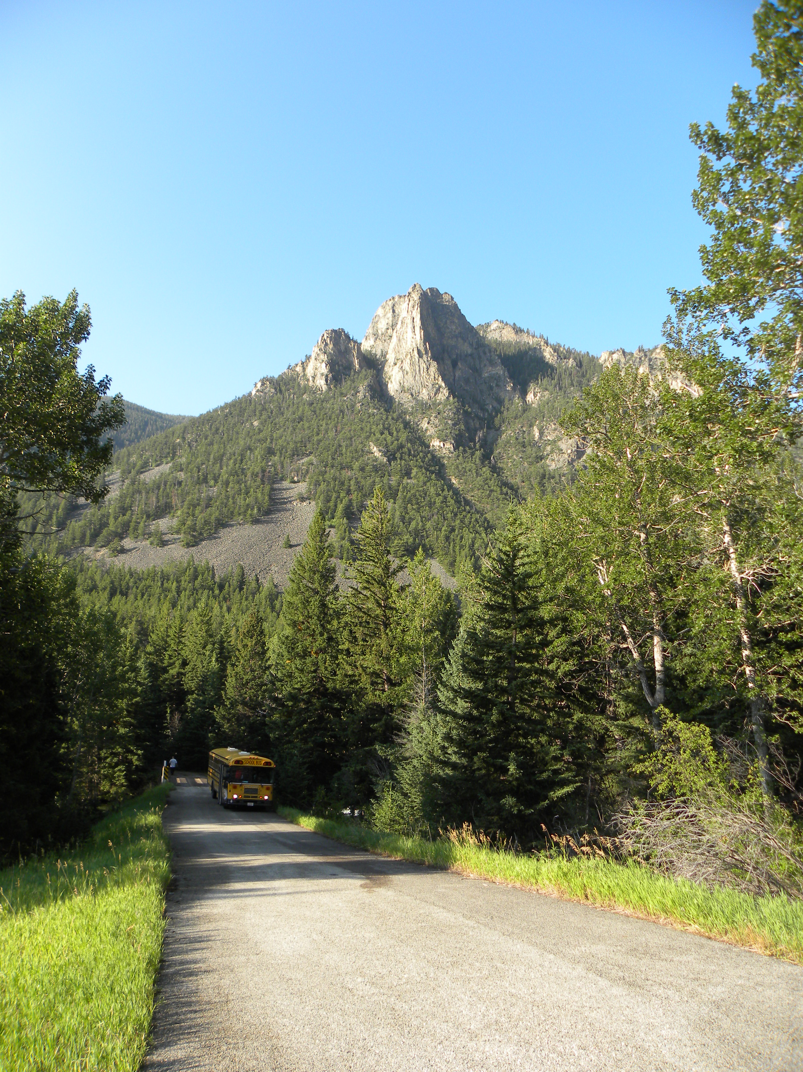
Westminster Spires Camp
Westminster Spires Camp is a ministry of Yellowstone Presbytery. This beautiful camp located seven miles south of Red Lodge, Montana, on Highway 212, provides a traditional camp experience along the shore of Rock Creek and at the base of Westminster Spires. The facilities include three dormitory style cabins, four staff cabins, a building for crafts, worship and presentations, a dining hall, and a building with showers and bathrooms for men and women. The camp is designed to comfortably accommodate 50 people.
Westminster Spires is located at the base of the spectacular Beartooth Highway which leads to the northeast entrance of Yellowstone Park. The camp has easy access to fishing, hiking and backpacking in the Absaroka Wilderness and is within close driving distance to rafting on the Stillwater River. This quiet mountain
setting is the ideal location for groups, families or individuals to enjoy the beauty of nature, spend time in fellowship with friends, worship, study and recreate in one of the most beautiful parts of the Rocky Mountains, or simply spend time in silence and solitude.
This seasonal camp provides a youth camping program during the month of July. Donations of time, talents, in-kind donations of equipment and supplies and/or
financial gifts help support this ministry. Volunteers serve as staff for the camping program and assist in maintaining the property and facilities. Financial support is utilized to upgrade equipment, provide basic supplies and to supplement the camp program. If you would like to participate in, or support this ministry in any way, please contact Curt Kochner at 406-259-7368, or by email at ckochner@mcn.net.

Slide 3
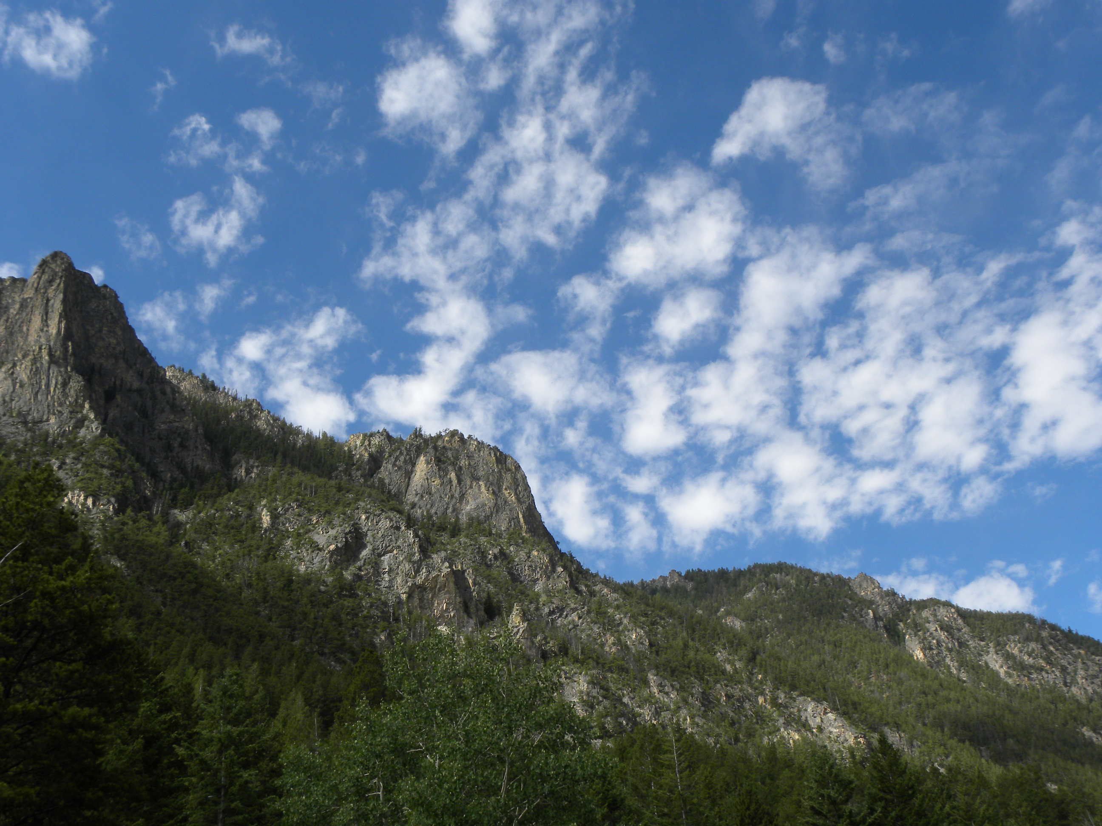

Slide 4
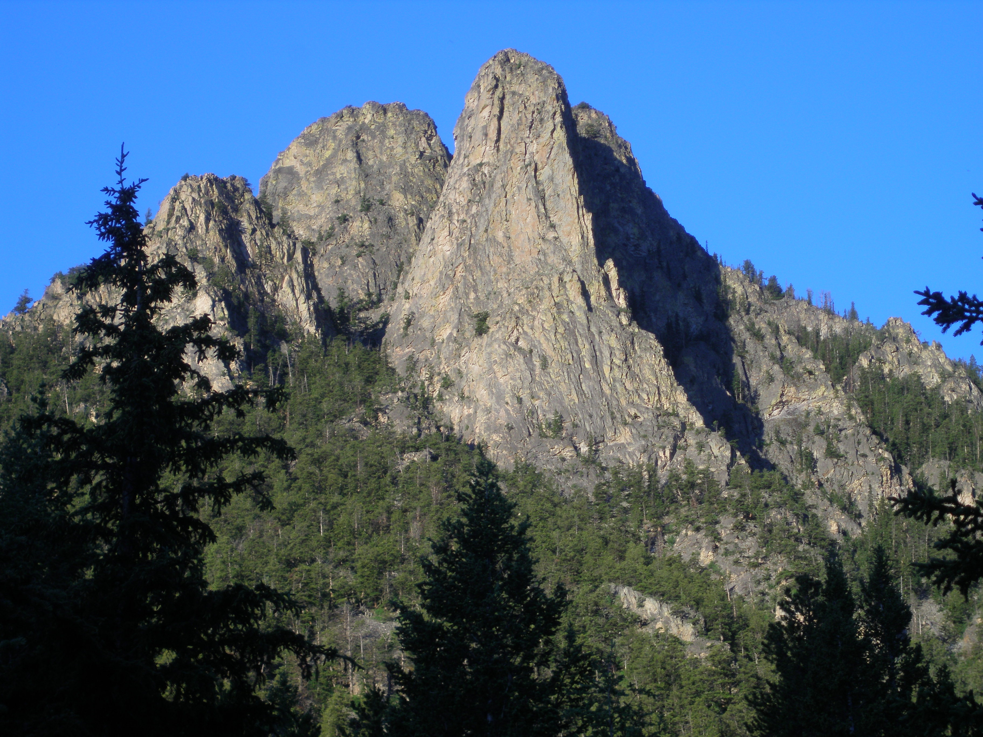

Slide 5
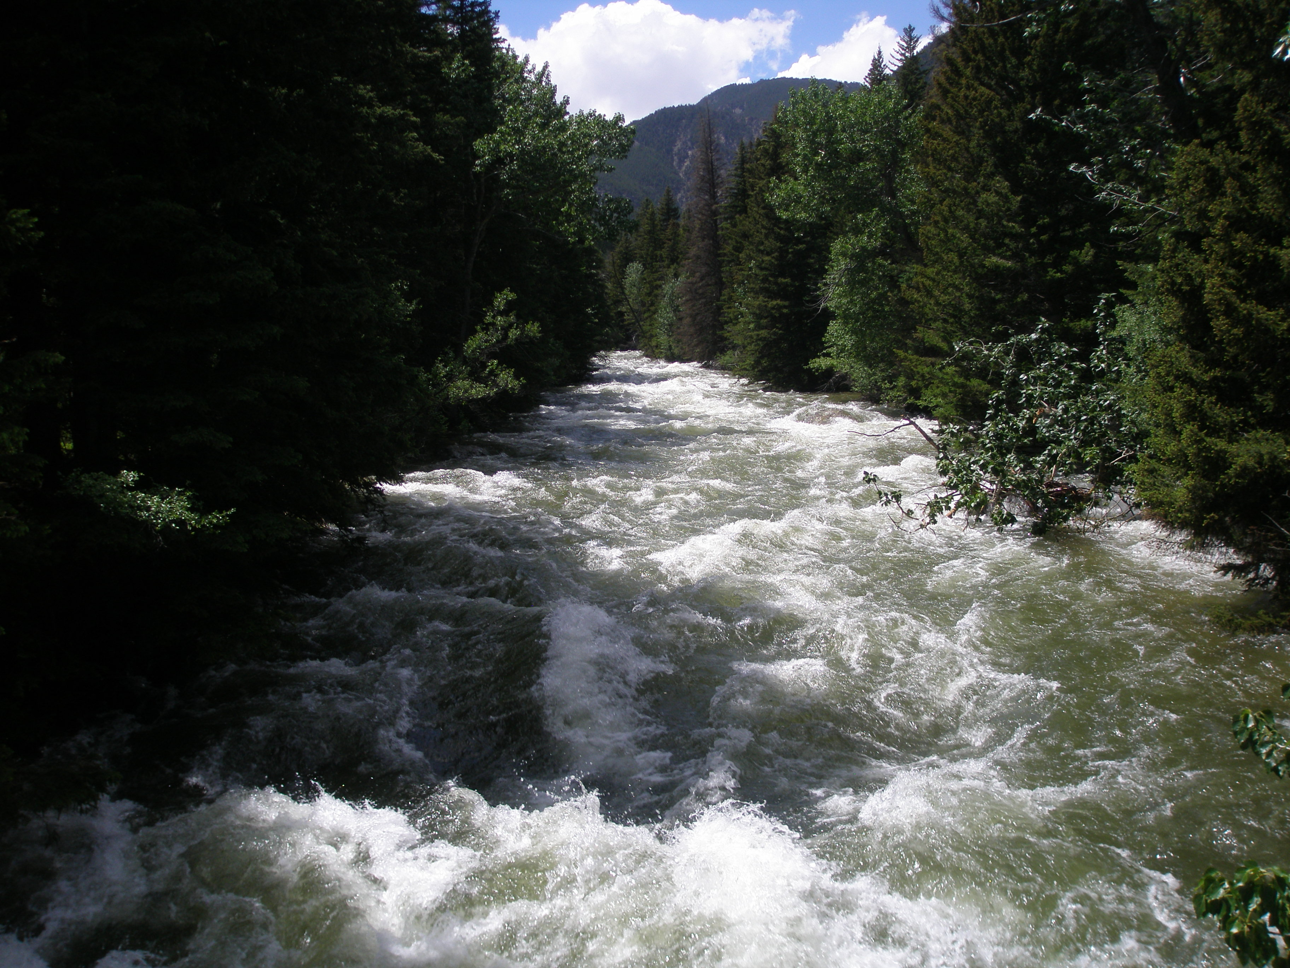

Slide 6
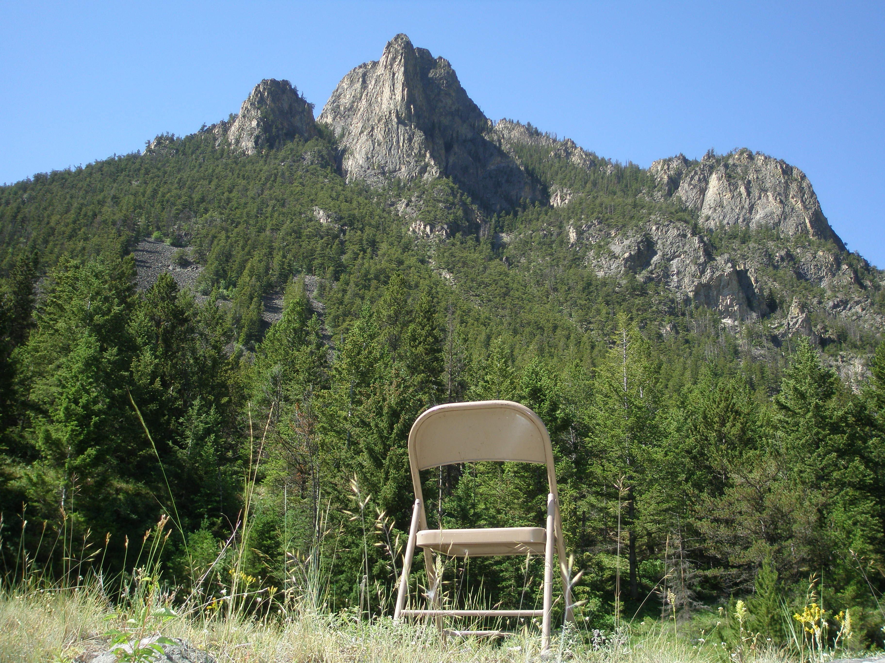

Slide 7
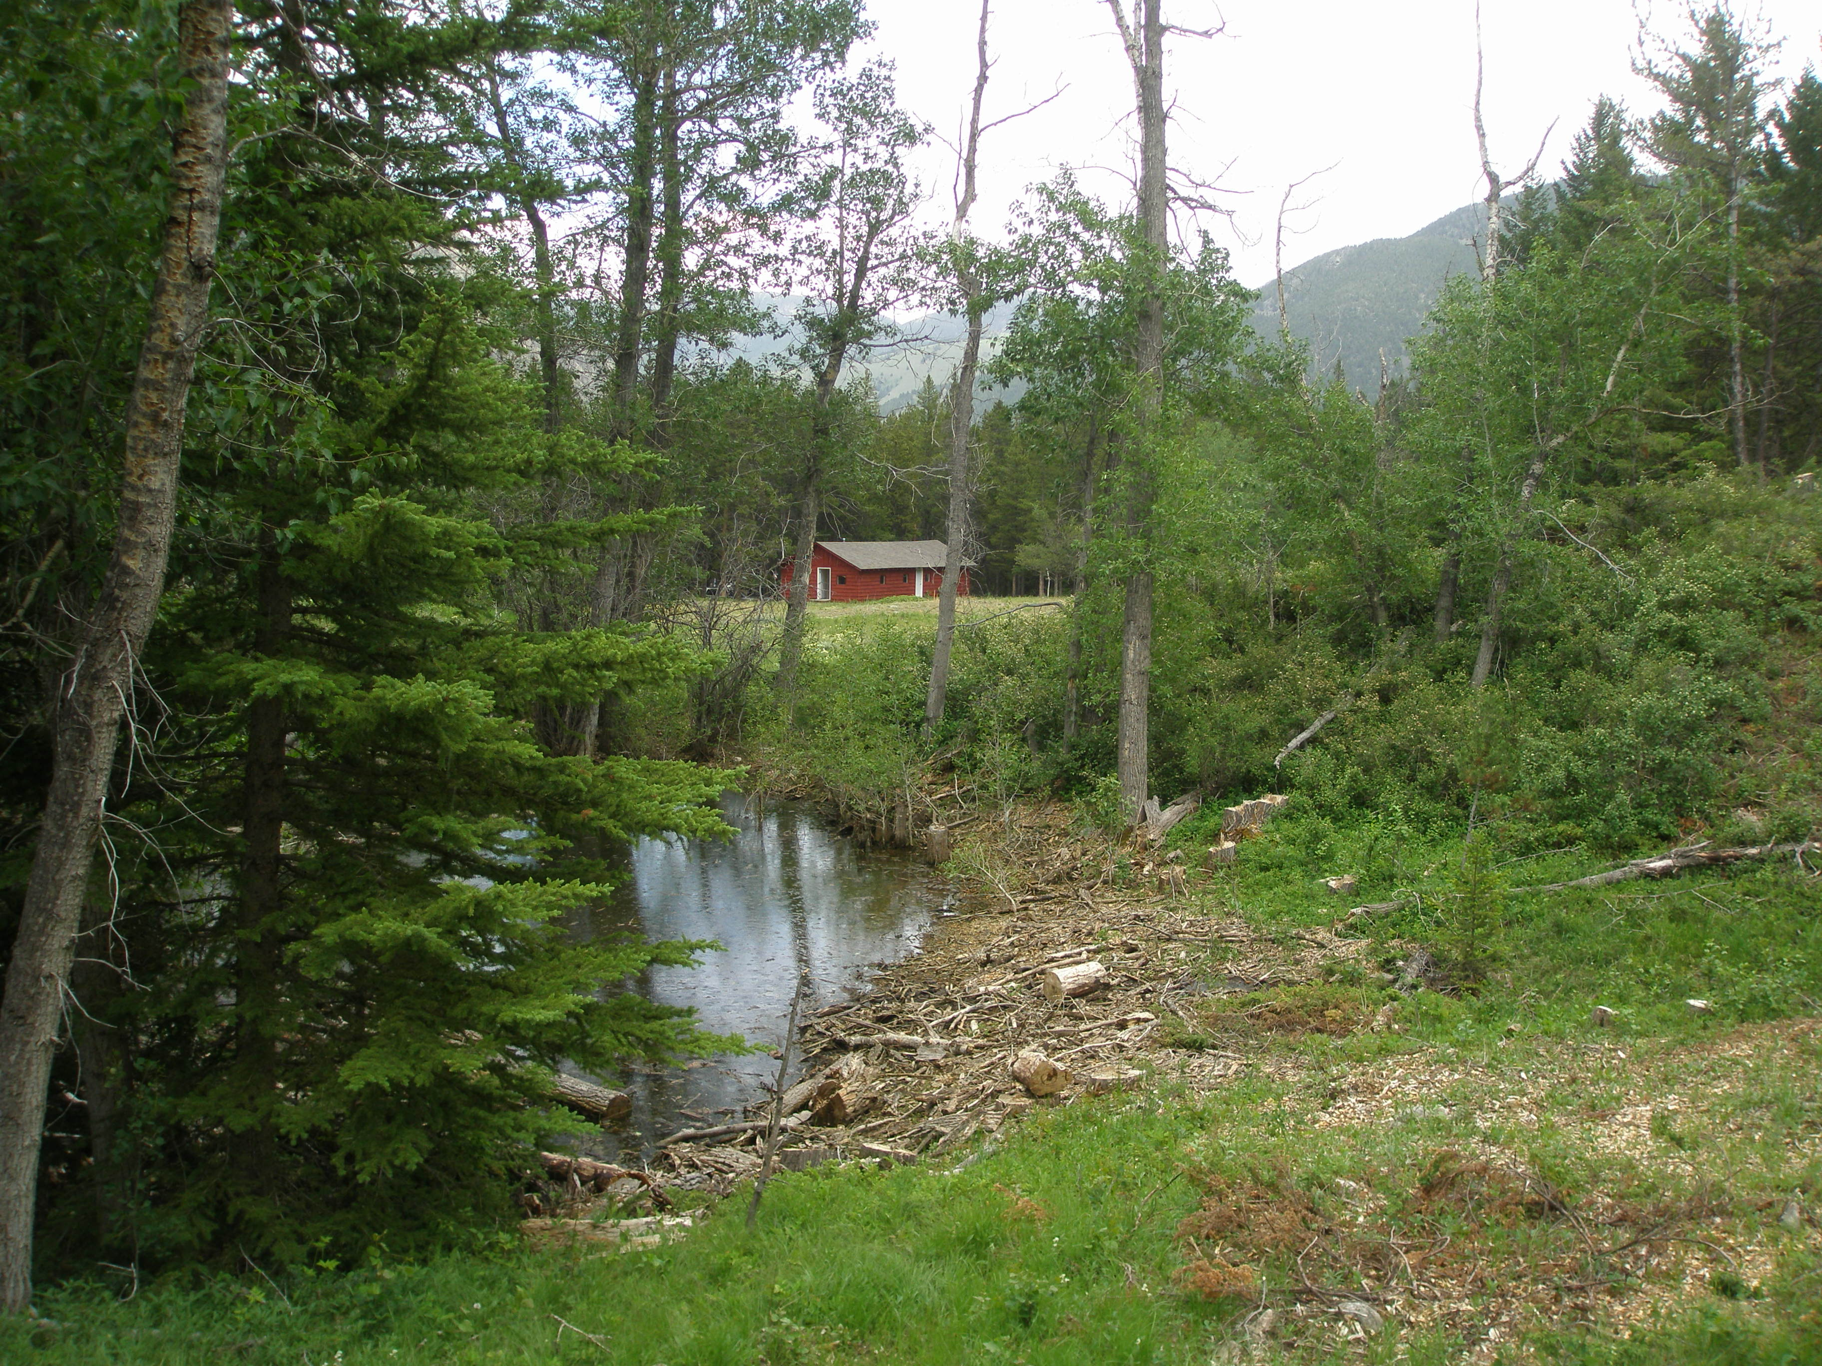
Craft Cabin

Slide 8
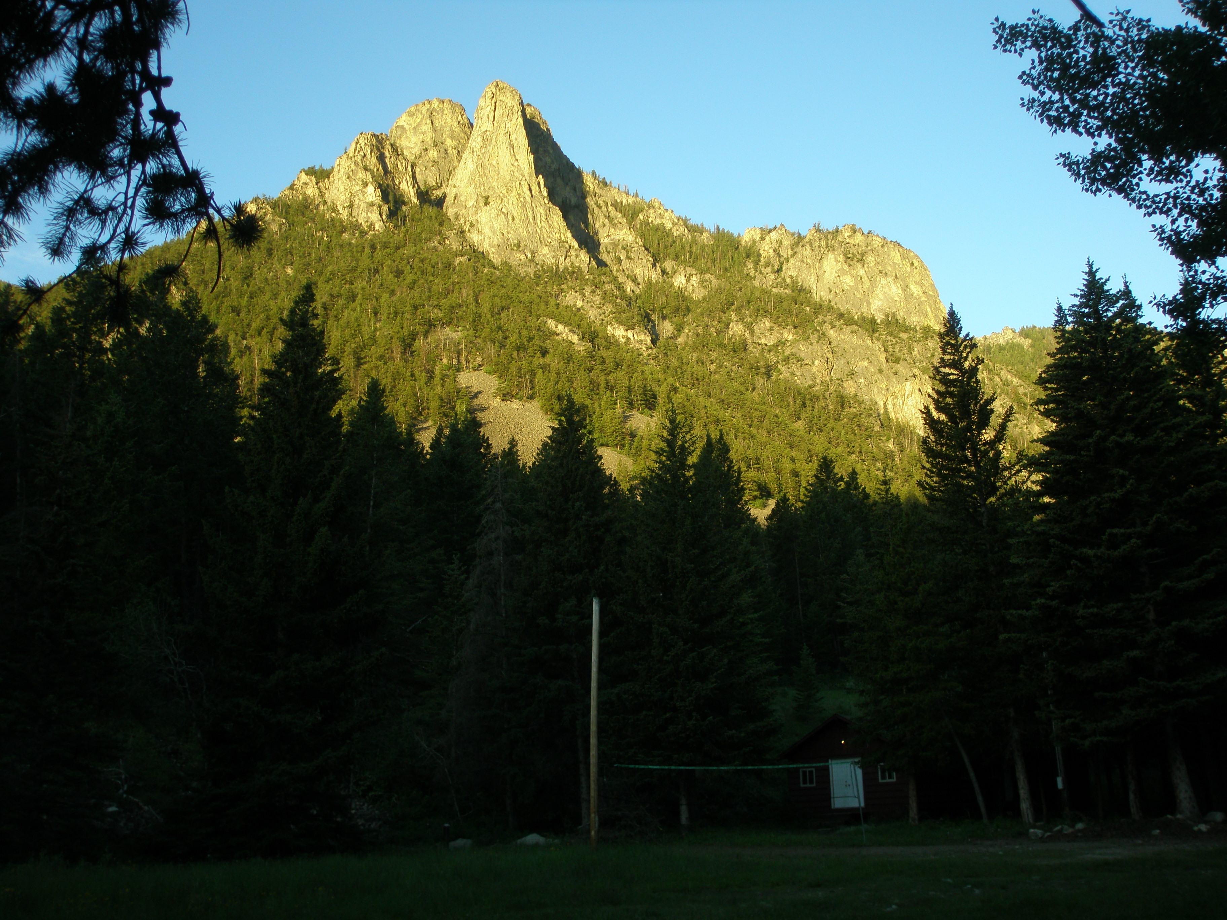

Slide 9
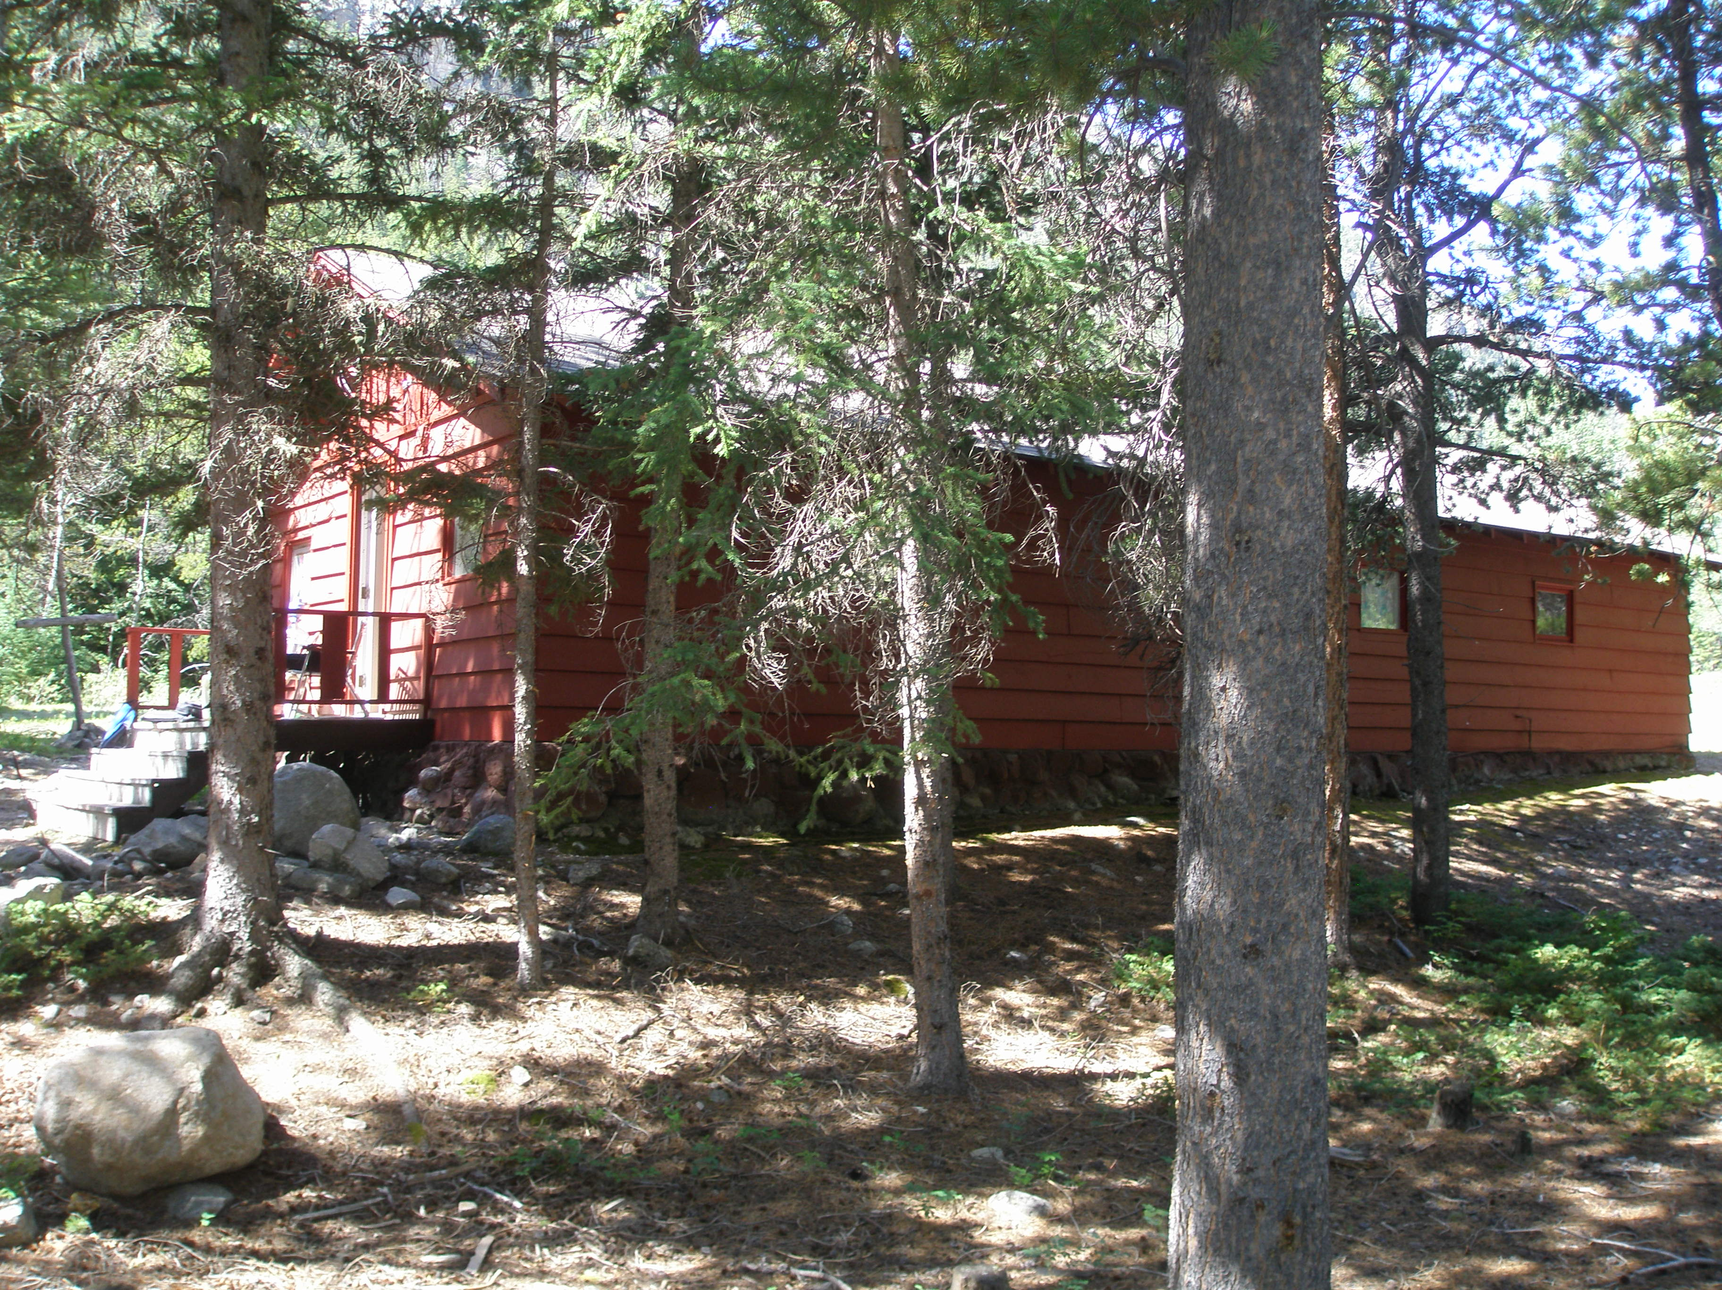
Craft Cabin

Slide 10
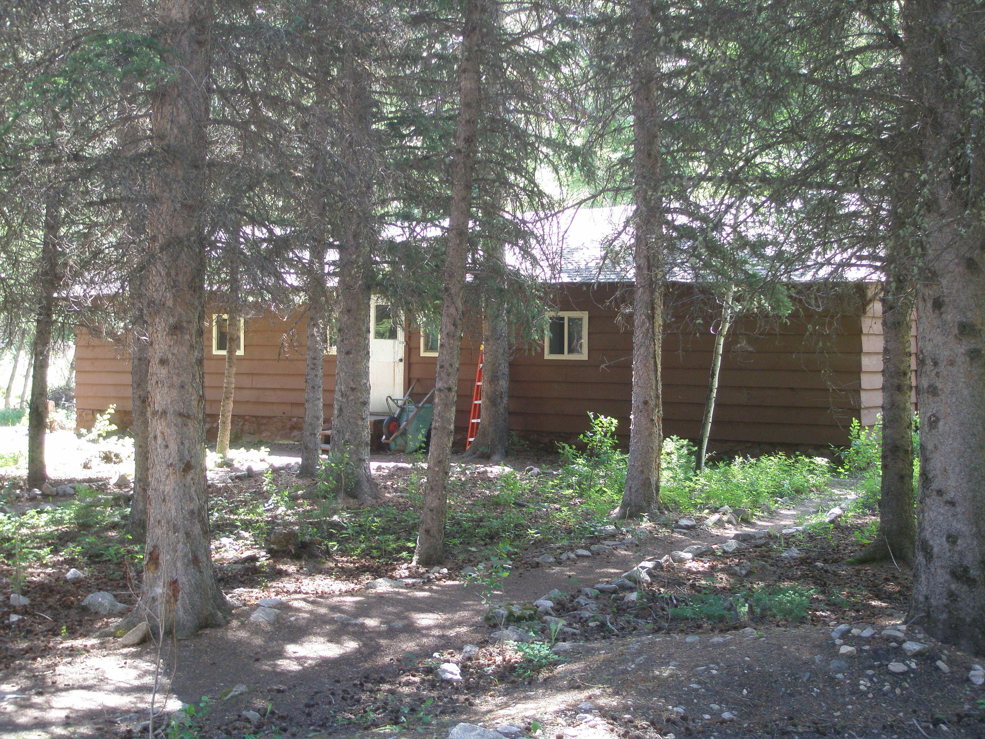
Split Cabin
6 bunks on each side
Tool Storage in middle

Slide 11
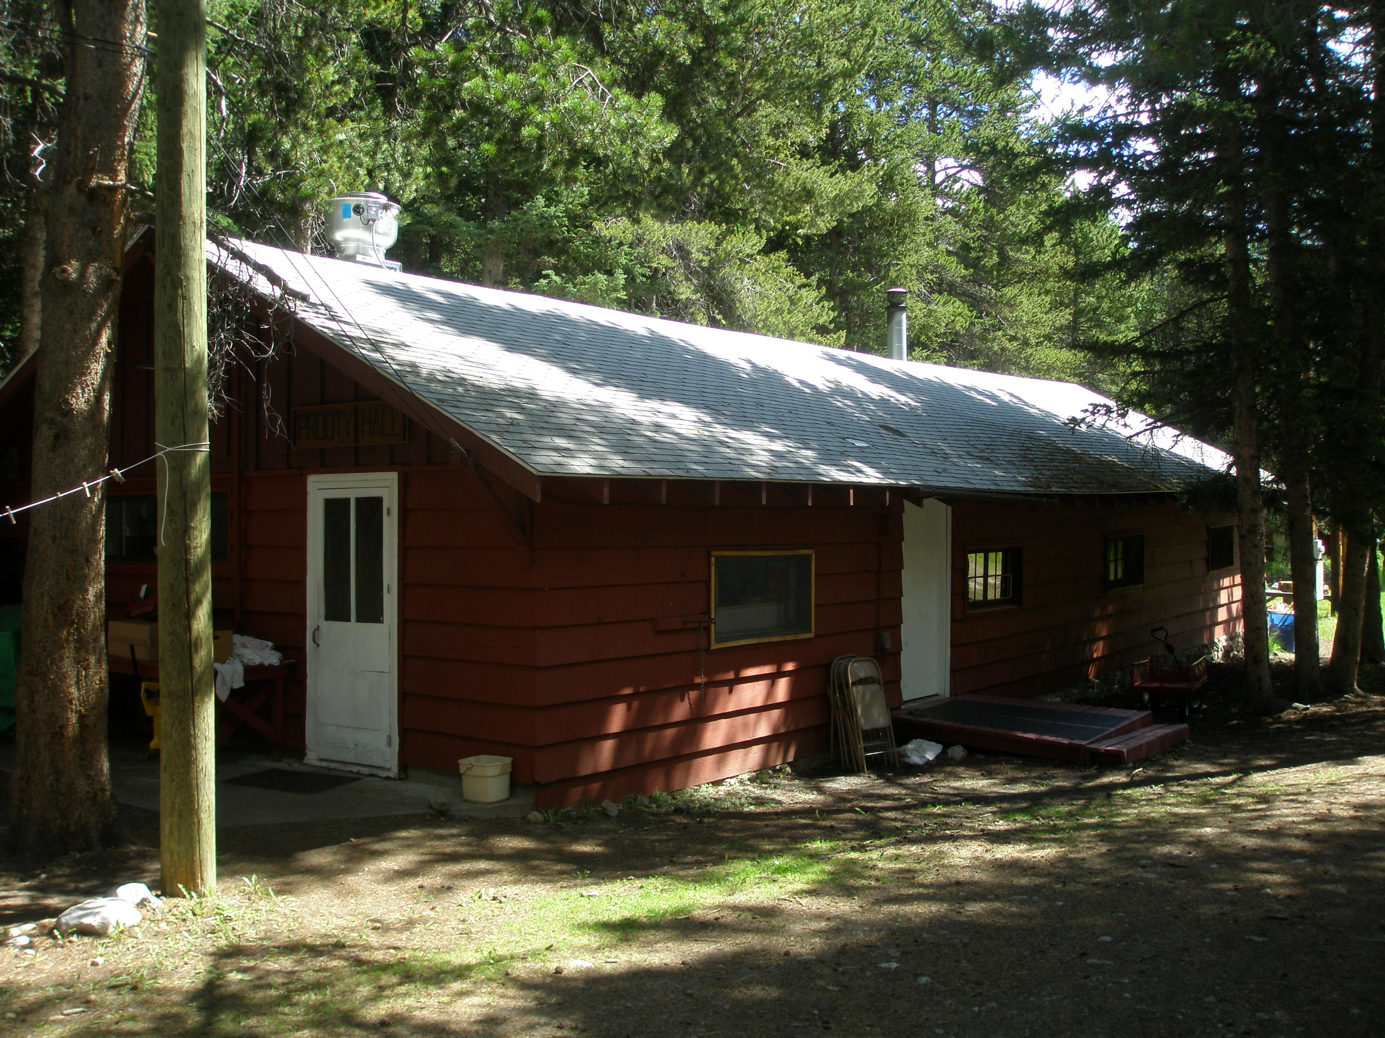
Prouty Dining Hall

Slide 12
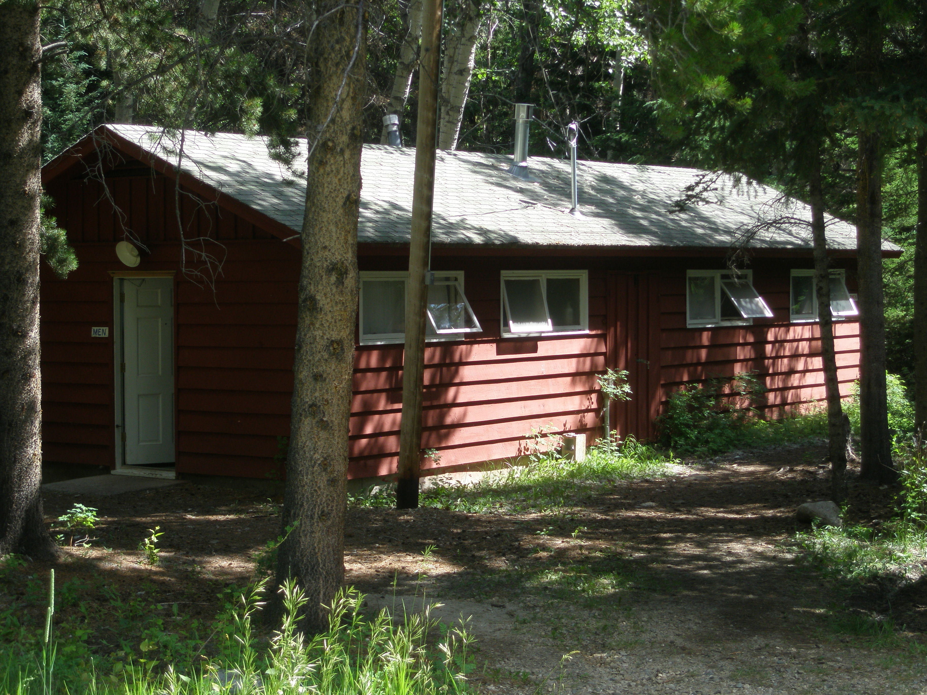
Bathrooms and Showers

Slide 13
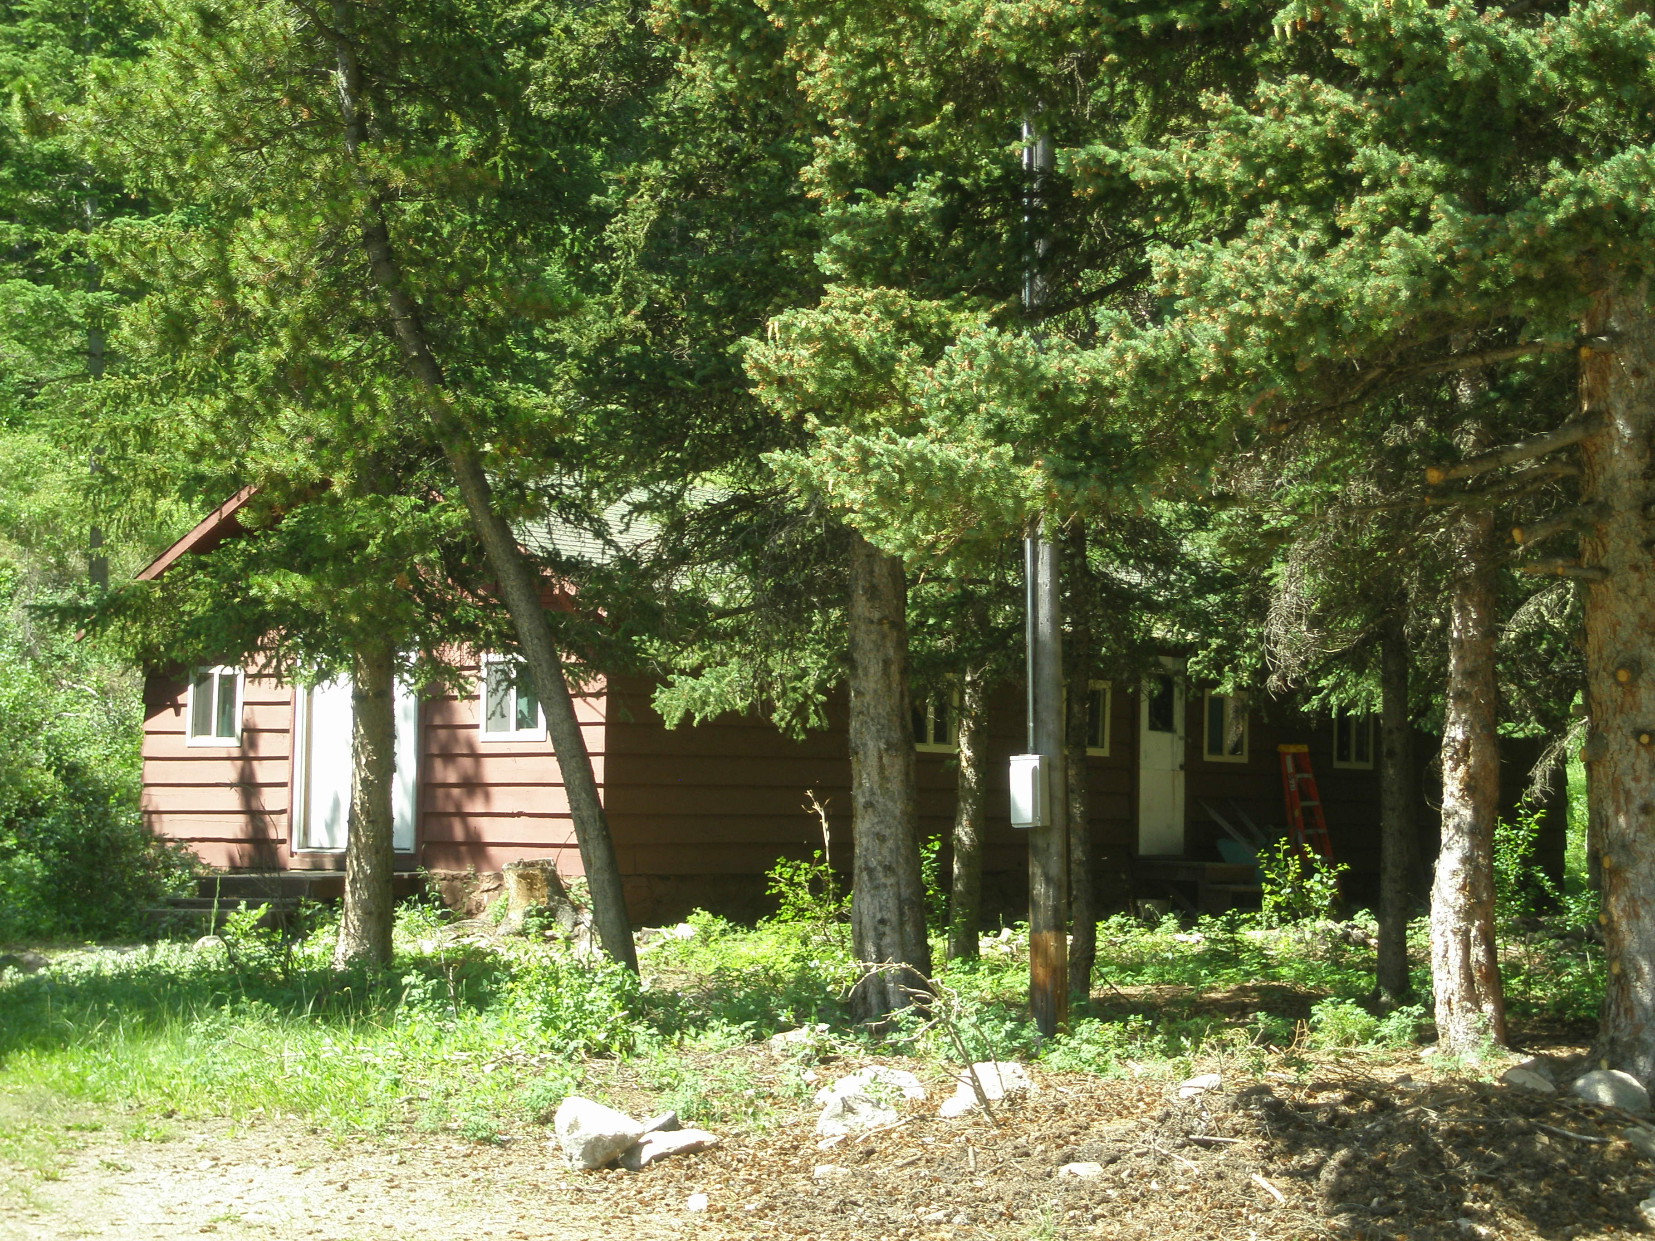
6 Bunk Cabin

Slide 14
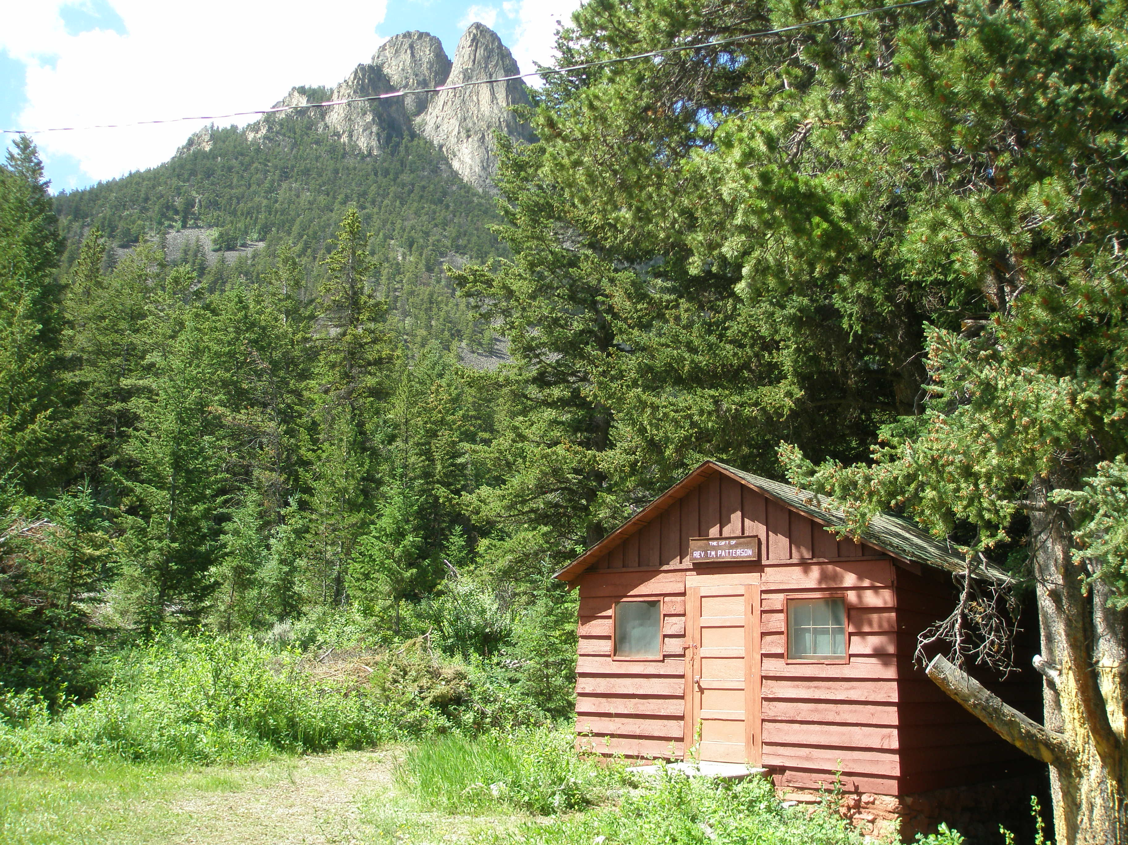
Patterson Cabin
4 Bunks

Slide 15
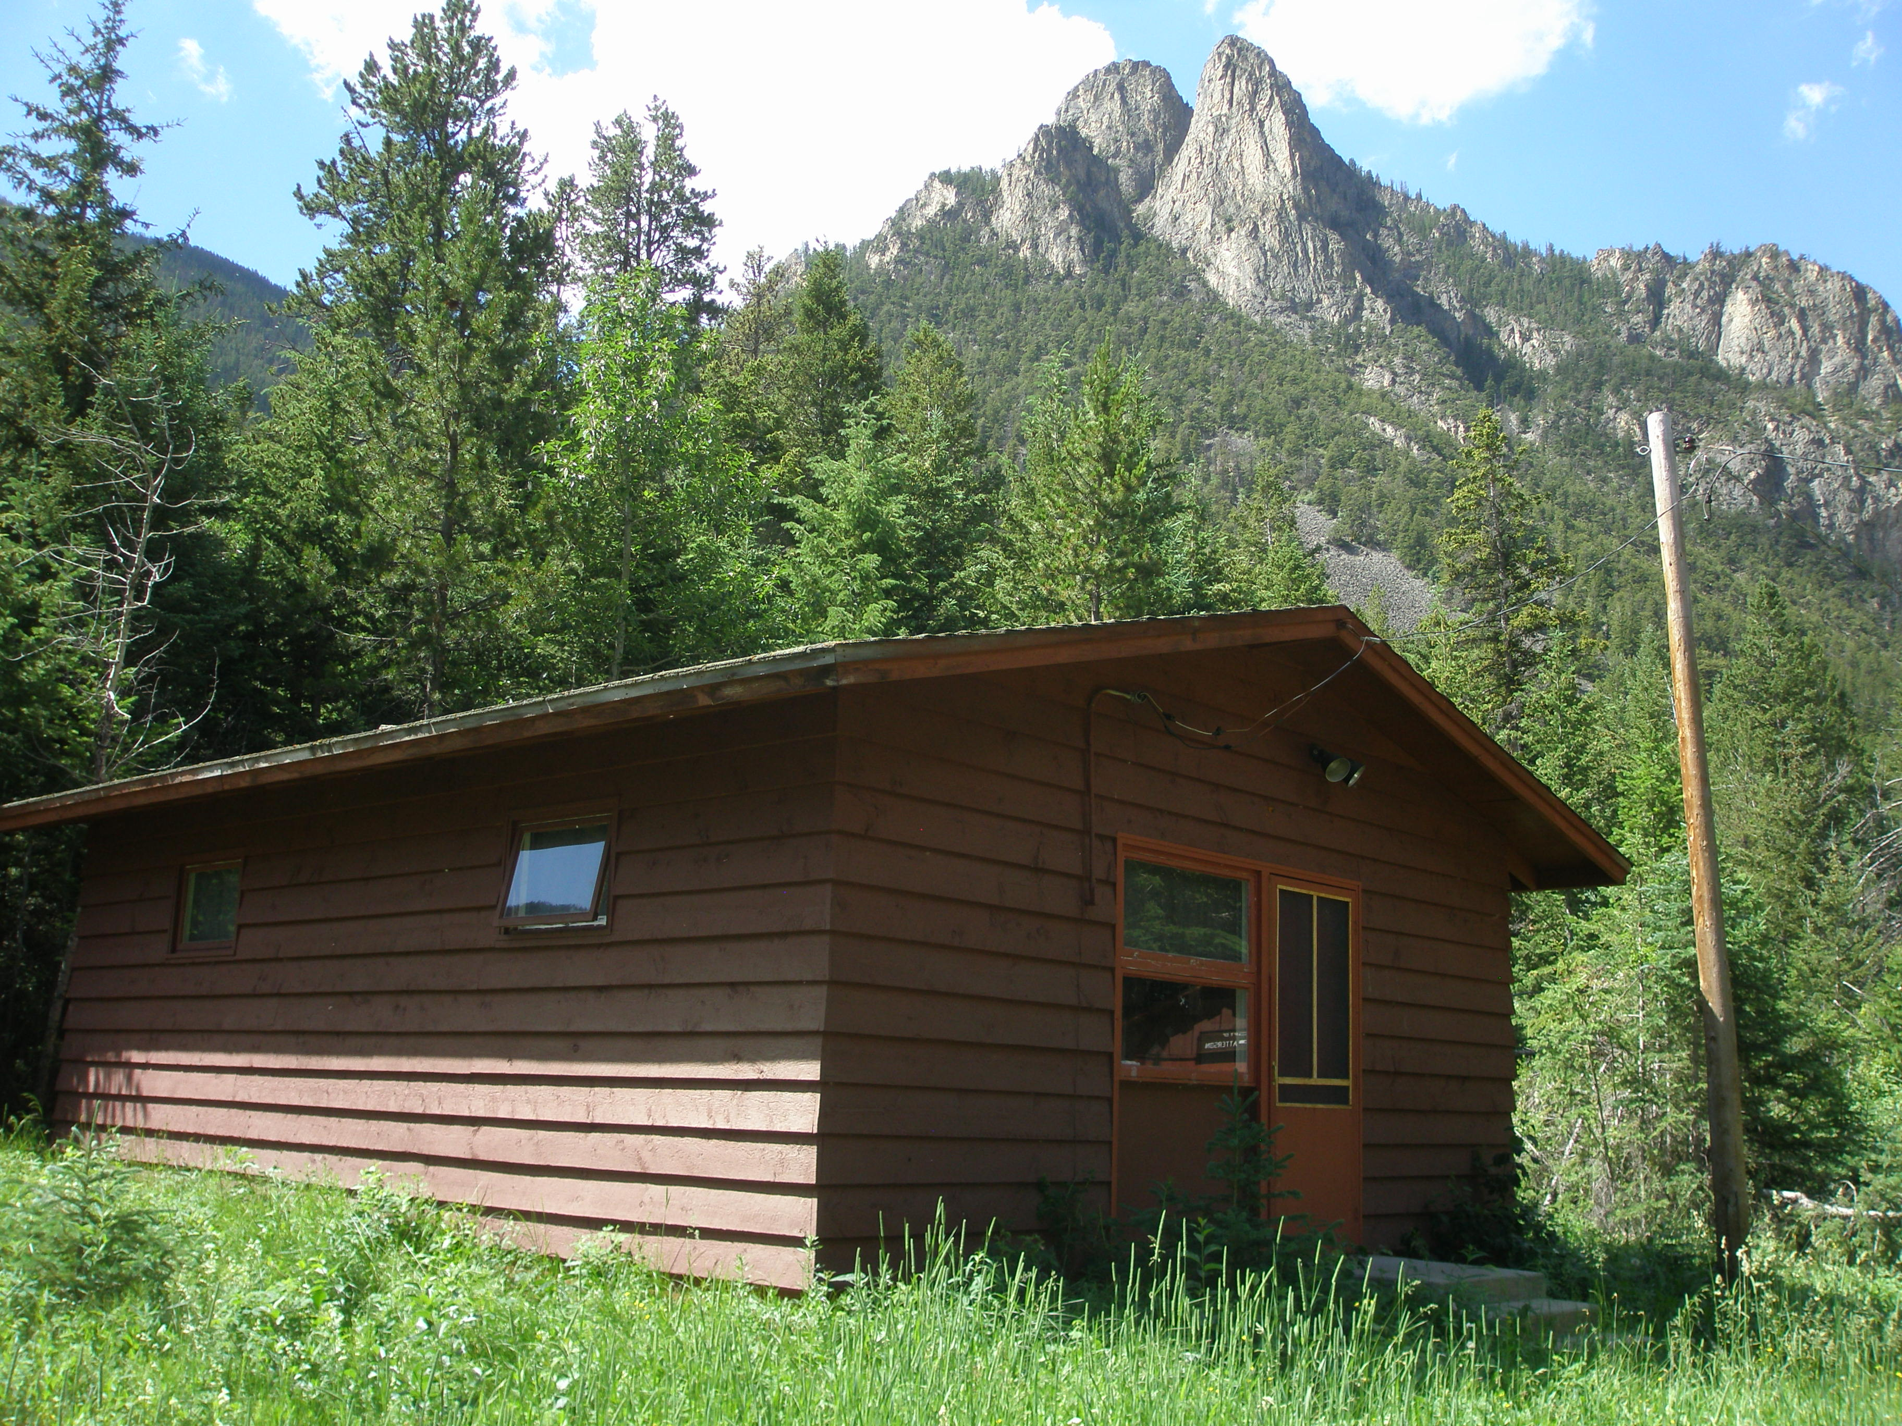
8 Bunk Cabin

Slide 16
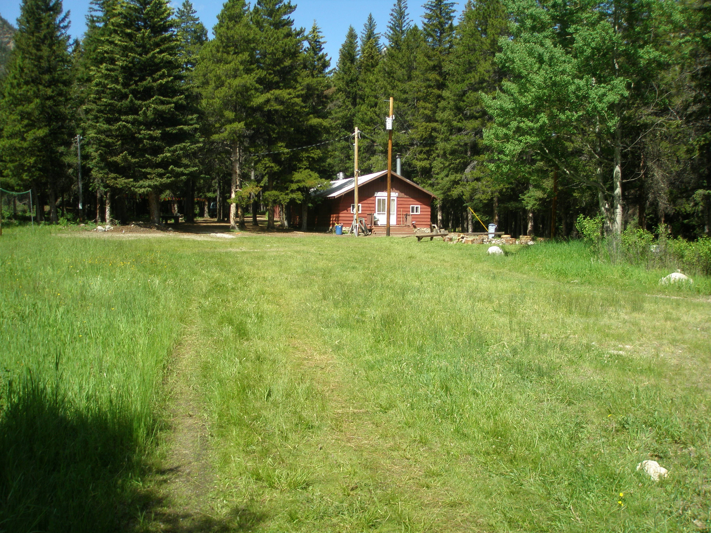
Prouty Dining Hall
Lower Meadow

Slide 17
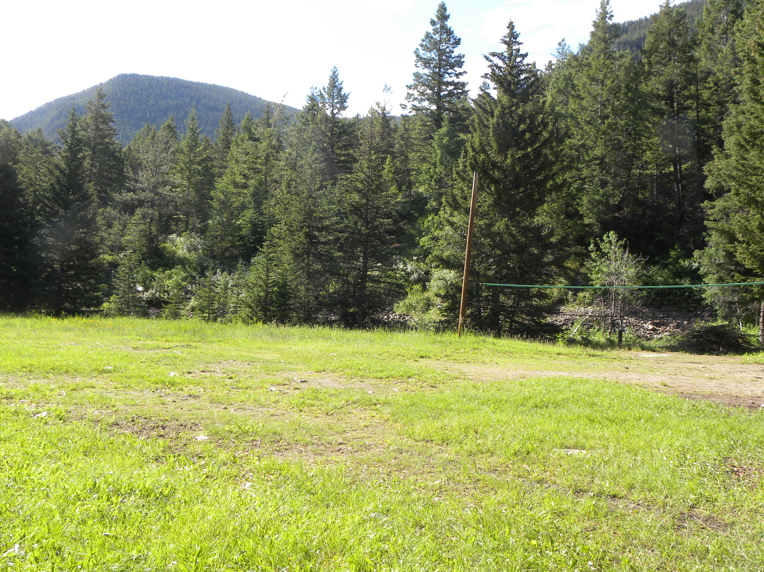
Lower Meadow

Slide 18
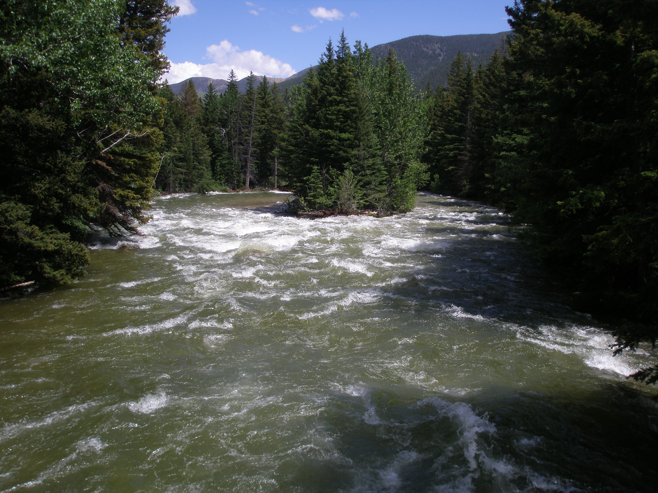

Slide 19
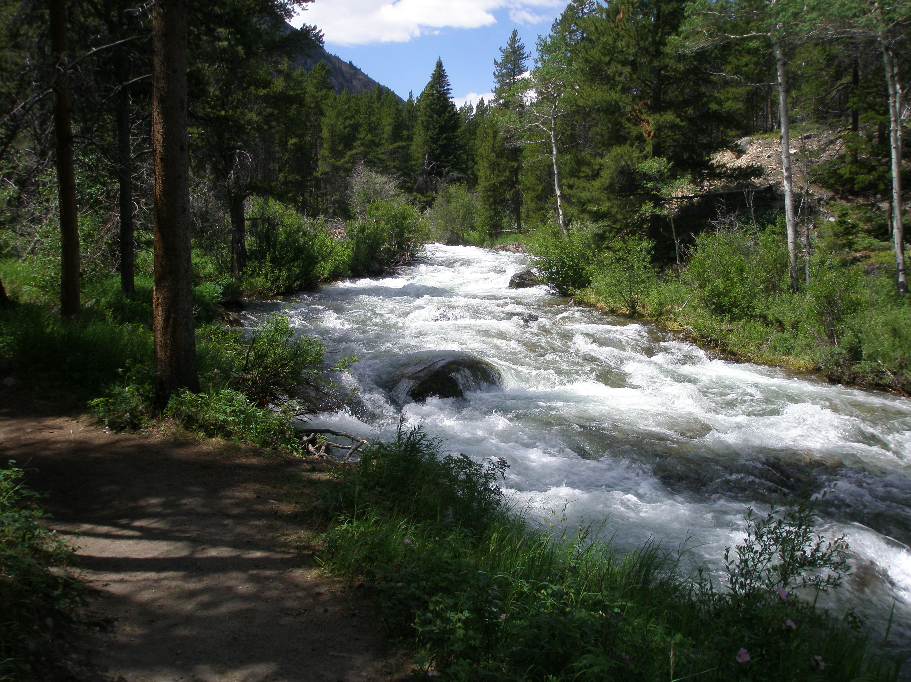

Slide 20
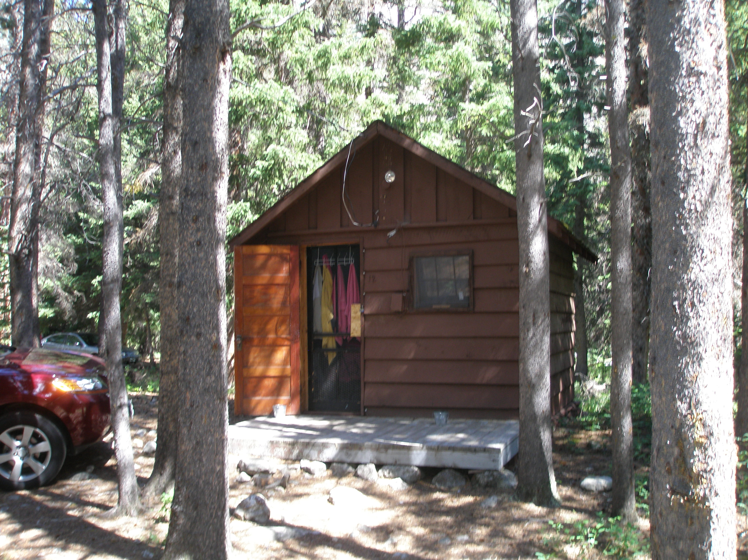
Cook’s Cabin

Slide 21
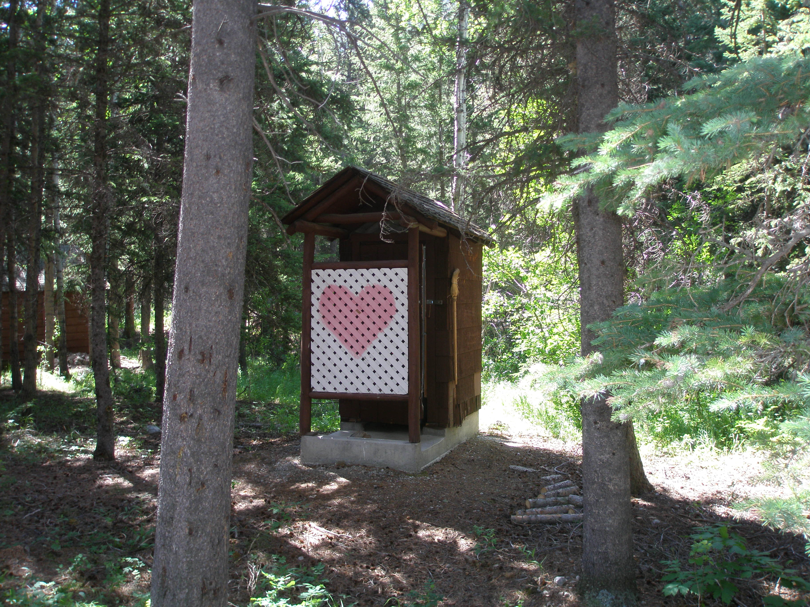

Slide 22
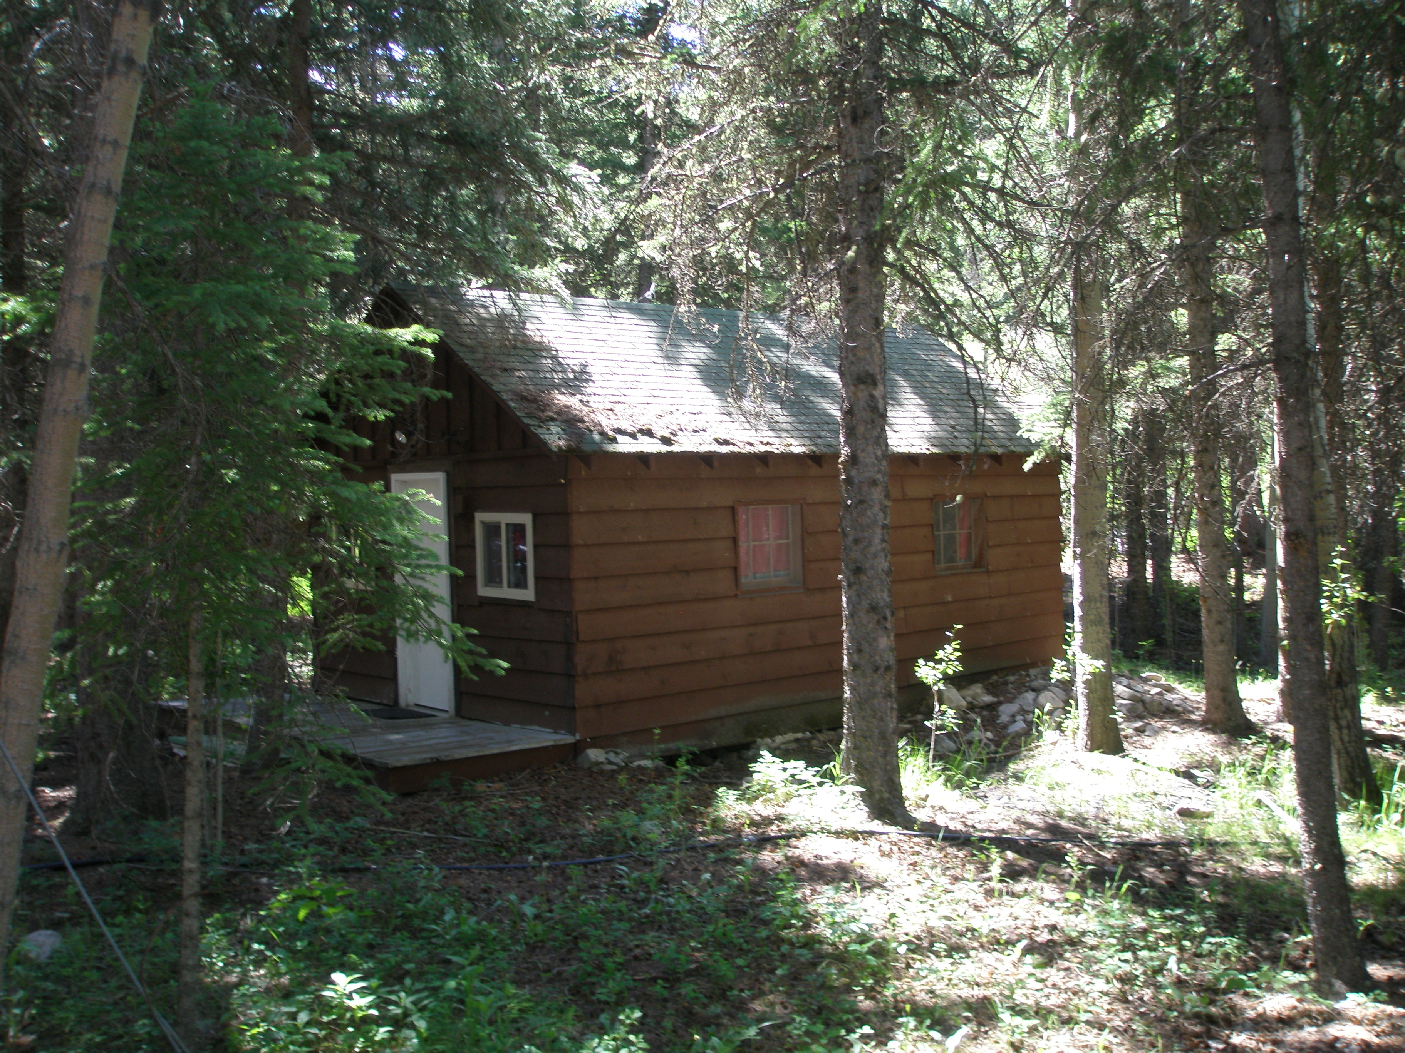
Dean’s Cabin

Slide 23
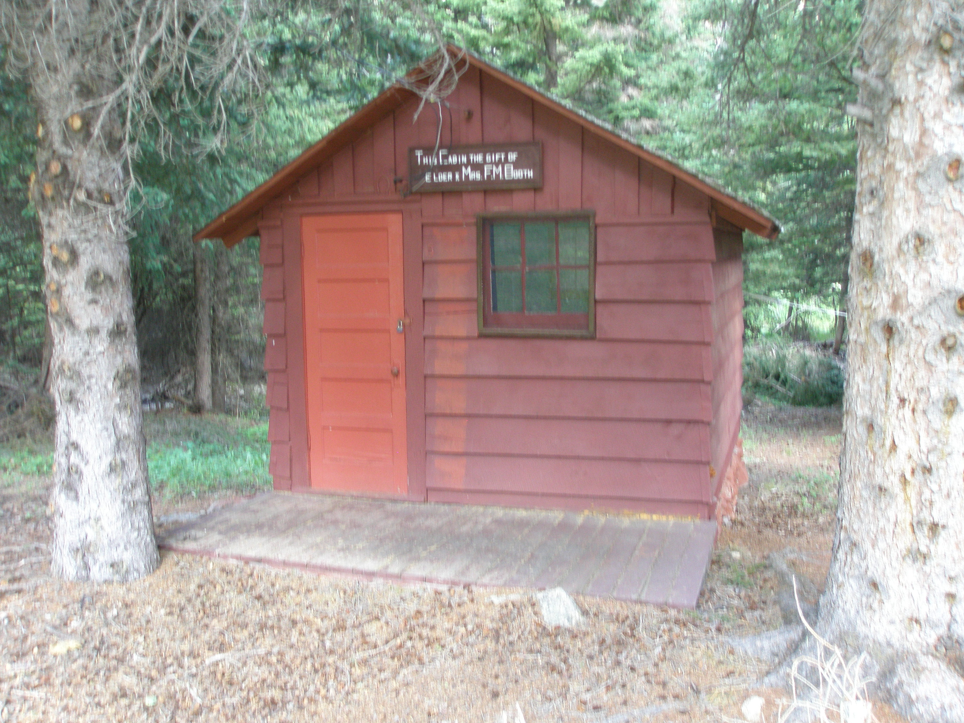
Two Bed Cabin

Slide 24
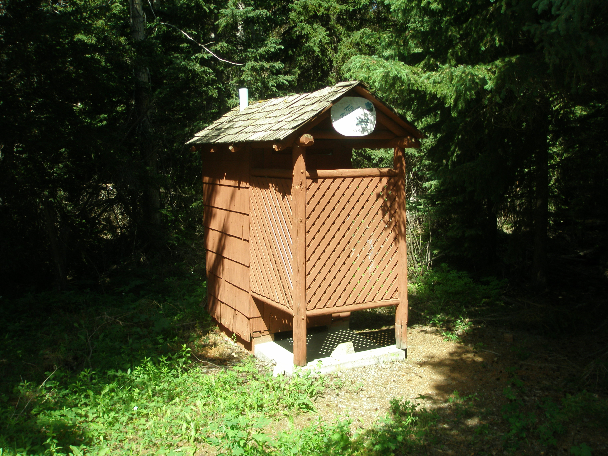

Slide 25
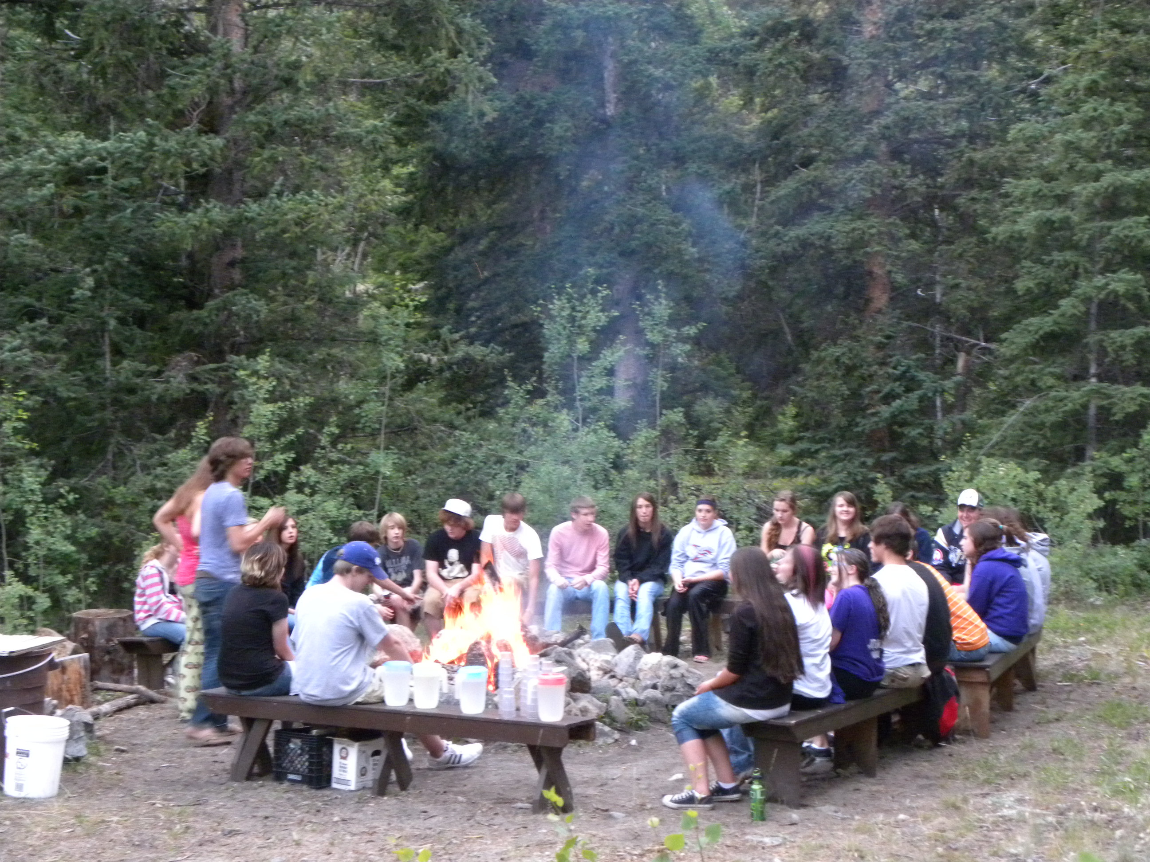
Lower Fire Pit

Slide 26
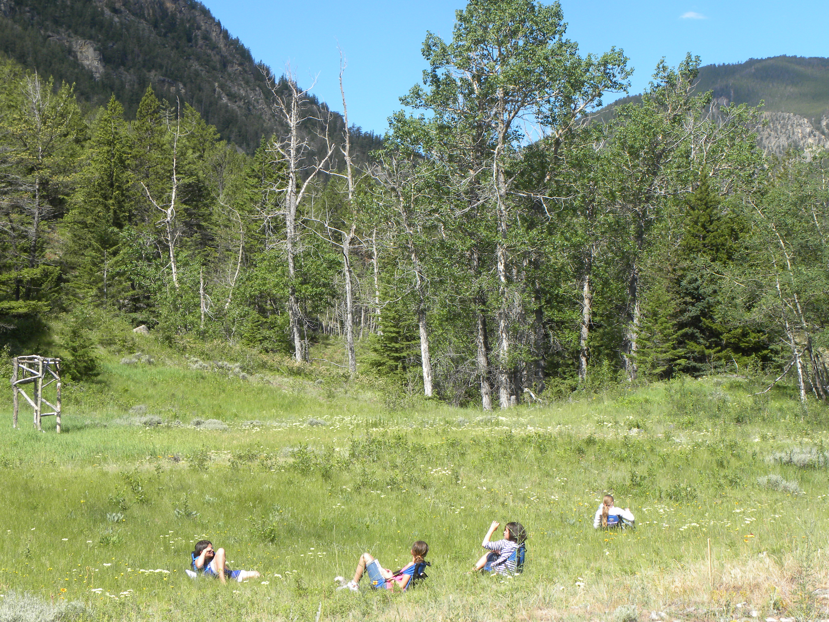
Upper Meadow

Slide 27
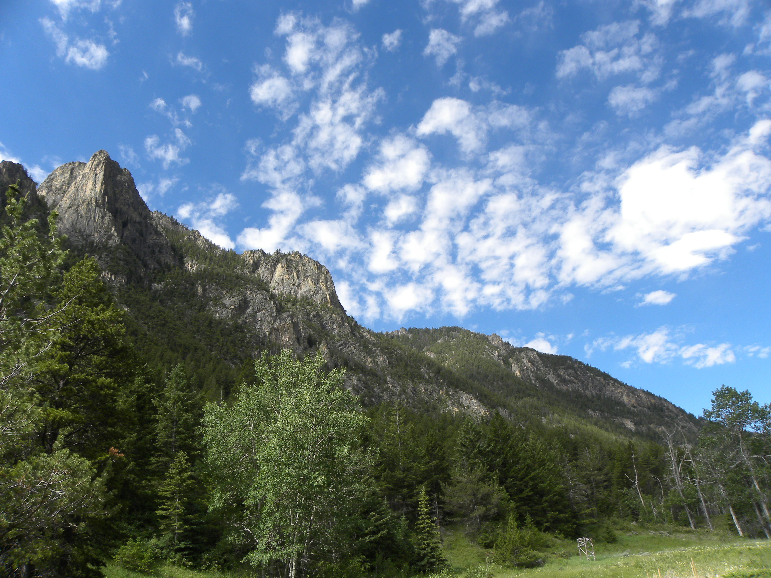
Upper Meadow

Slide 28
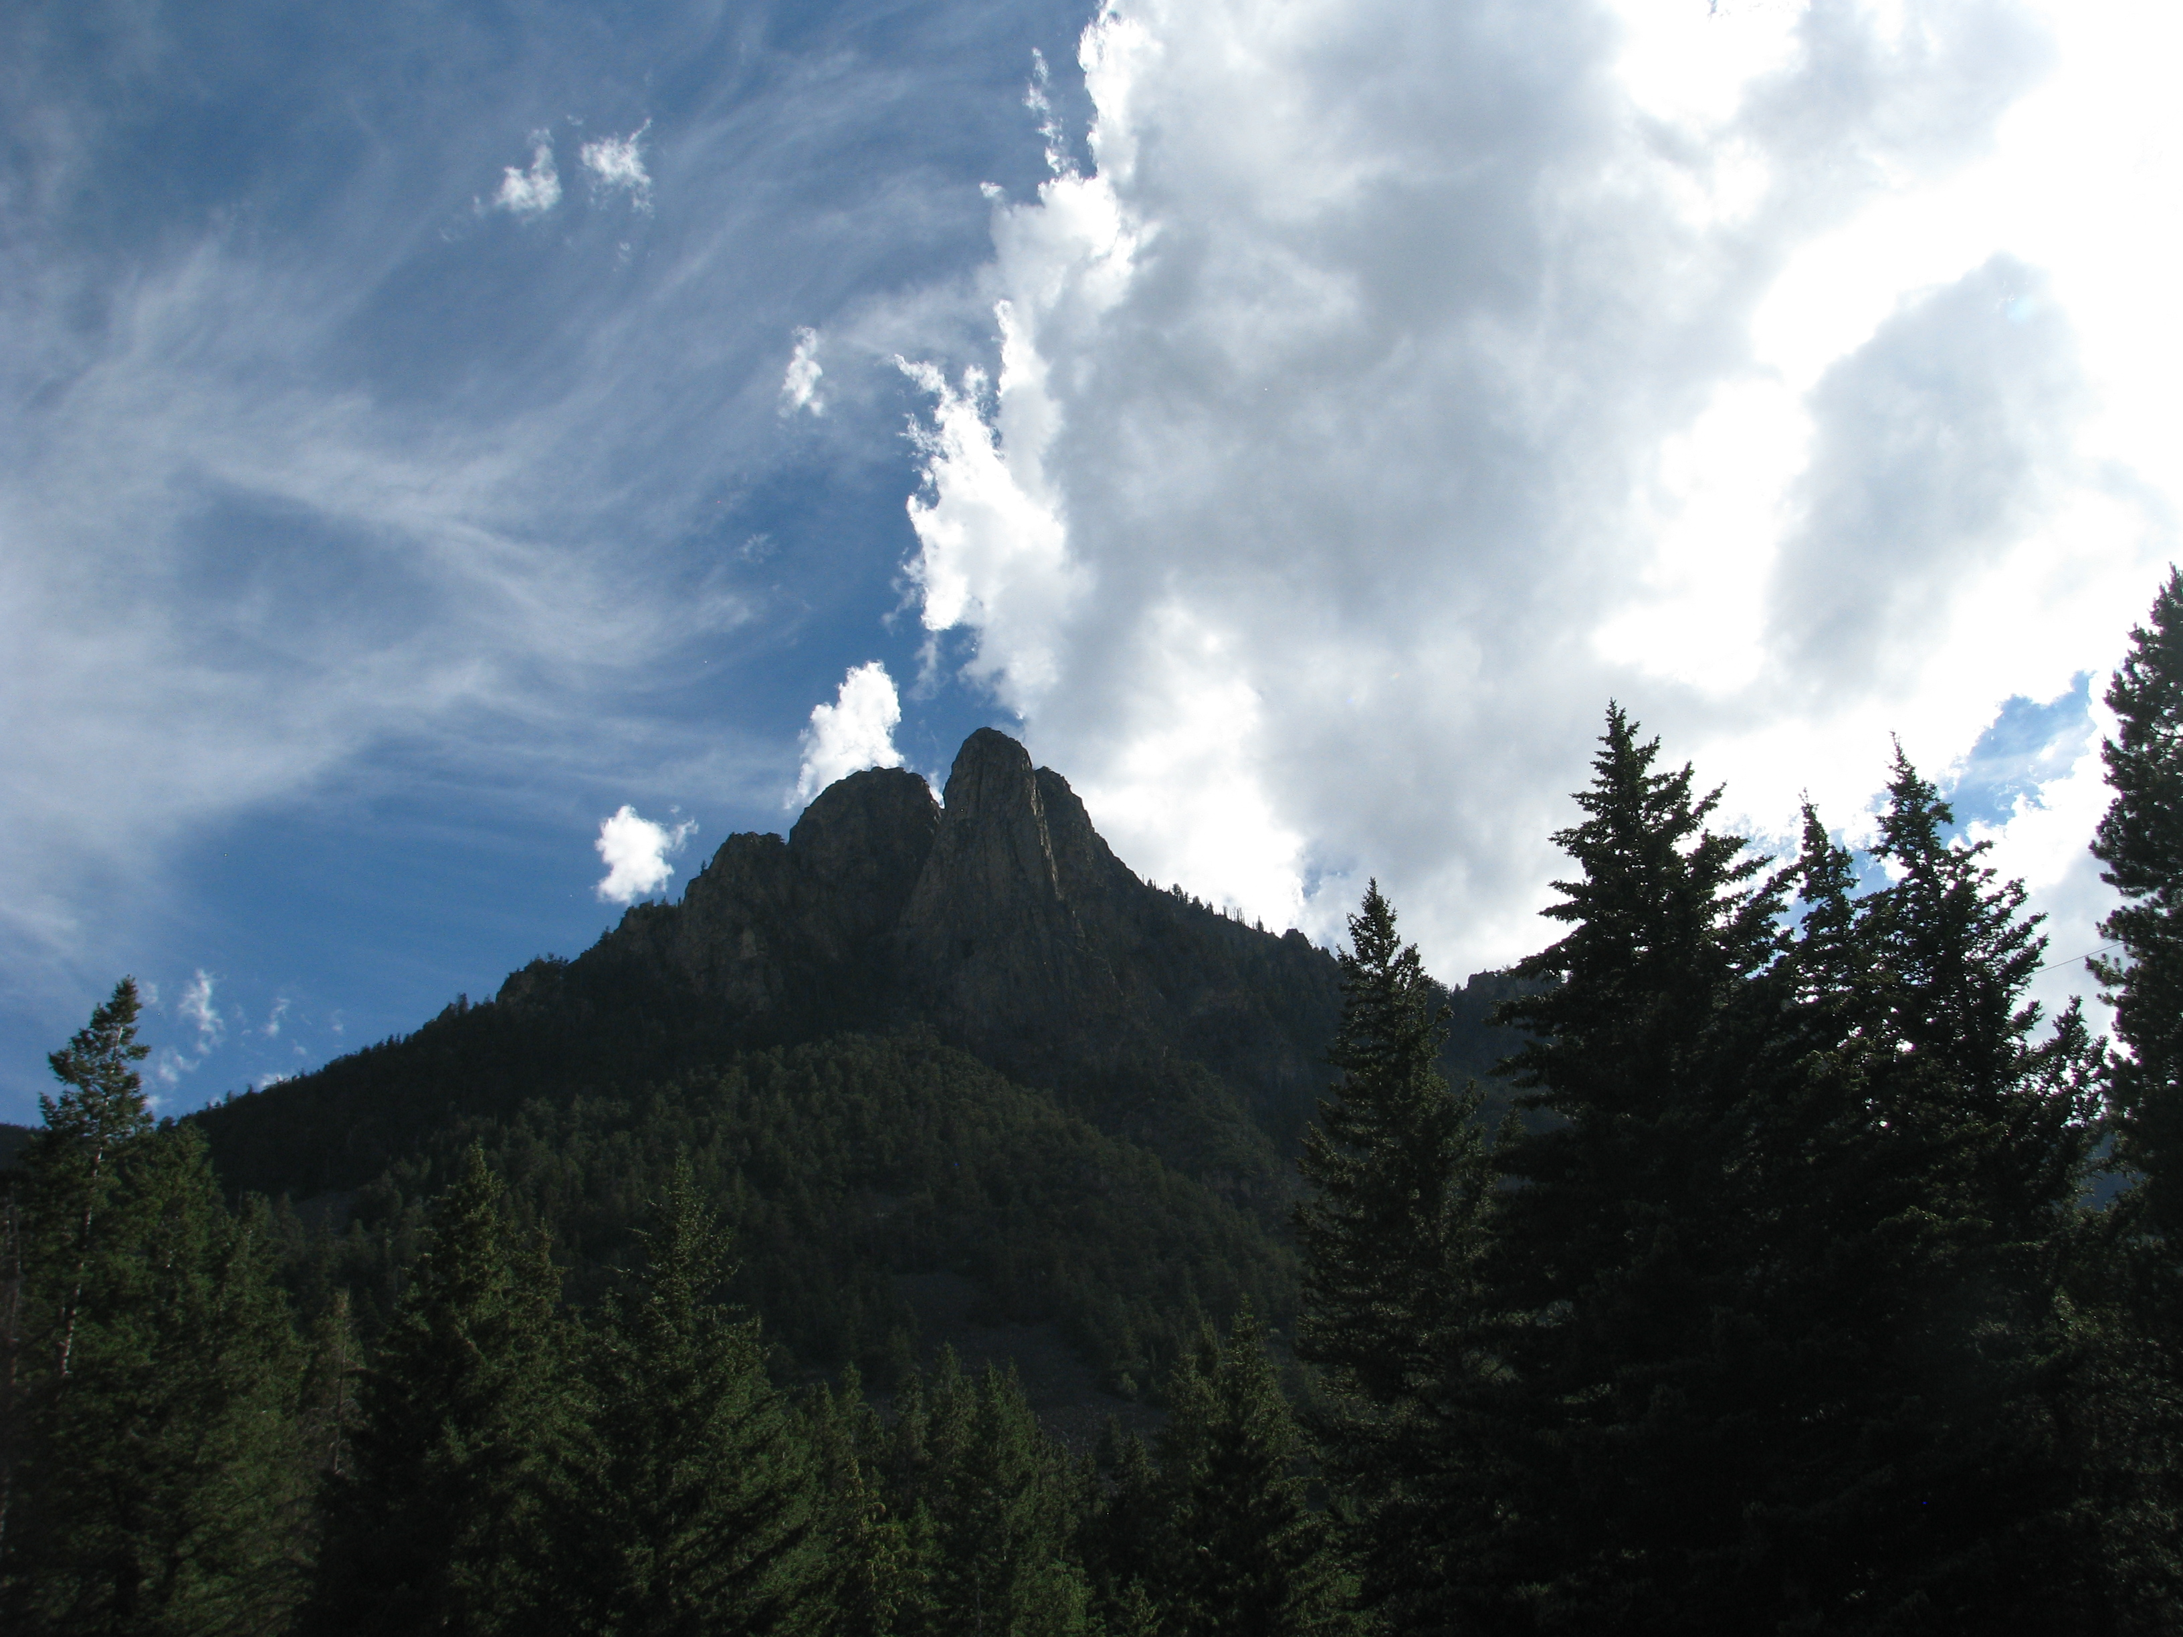

Slide 29
